Slide 1
The Complete JavaScript Course 2022: From Zero to Expert!
A brief Introduction to Javascript
JavaScript Fundamentals part 1
JavaScript Fundamentals part 2
Developer Skills and Vs console setup
JavaScript in the Browser: DOM and Event Fundamentals - Guess my Number
JavaScript in the Browser: DOM and Event Fundamentals - pop up modal window
JavaScript in the Browser: DOM and Event Fundamentals – Pig Game
How JavaScript works behind the Scenes

Slide 2
A BRIEF INTRODUCTION TO JAVASCRIPT

Slide 3



Javascript is one of three core languages that are used to build websites.
HTML 5 is responsible for the content of the page, text, images, links etc.
CSS 3 is responsible for the presentation. I.e layout, positioning, font sizes, colours etc.
JS is used to add dynamic and interactive effects to the webpage, manipulate content or CSS and build entire web applications in the browsers.
JavaScript has many popular frameworks that allow us to write code easily. Examples are jQuery, angular etc.
Javascript is a front end language that interacts with the user and the backend languages like PHP. JavaScript can also be run in the backend server-side as a browser independent application using tools like Nodejs.
A brief Introduction to Javascript
HTML 5
CSS 3
JAVASCRIPT

Slide 4
Javascript Releases
Minor updates to Javascript every year
Biggest ever update to the language
ES6 / ES2015
ES7 / ES2016
ES8 / ES2017
ES9 / ES2018
ES10 / ES2019
ES11 / ES2020
ES5
Modern JavaScript
ECMAscript

Slide 5
JAVASCRIPT FUNDAMENTALS PART 1

Slide 6
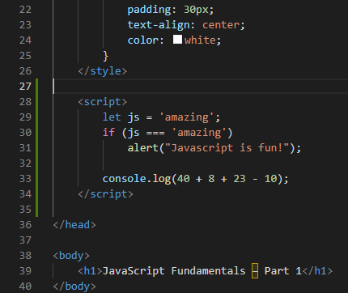
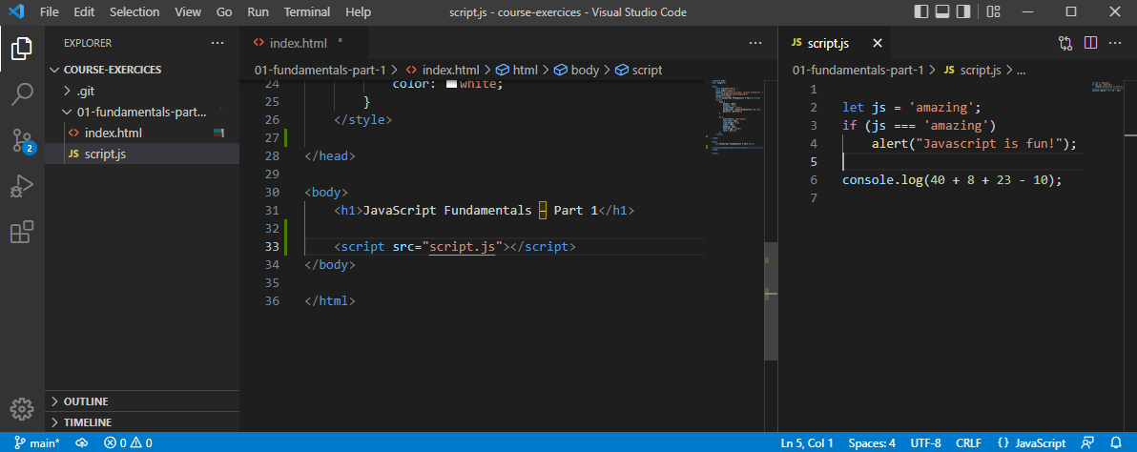
This is an example of inline script because the script code is within the html file within <script> tags.
Better to create a separate external Javascript file and link to it in the html file.

Slide 7
Javascript 7 primitive data types
1
Number
Floating point numbers. Used for decimals and integers i.e. let age = 23;
2
Strings
Used for text. Always put strings in quotes. Let firstName = “Jonus”;
3
Boolean
Logical values than can be true or false. Let fullAge = true;
4
Undefined
Value taken by a variable that is not yet defined. Let children;
5
Null
Also means empty value.
6
Symbol (ES2015)
Value that is unique and cannot be canged (Not usefull for now)
7
BigInt (ES 2020)
For integers that are too large to be represented by the number type.
Javascript has dynamic typing: We do not have to manually define the data type of a value in a variable. Javascript will automatically determine the data type.
Note that it is the value that has datatype and not the variable.
Variable X can be a Number then it can be a string in our code later on. This can cause some tricky bugs.

Slide 8
Let, const & var – 3 ways to define variables.
var
let
const
Var is the old way to define variables pre ES6.
Let is used to define variables that may change later on in our code.
Cosnt is used to define variables that never change.
Var should not be used but may exist in older code. Using var is still valid but it is a bad practice.
For example date of birth. This is an immutable variable because the birthday of a person can never change.
For example age is a variable that may change. It mutates yearly increasing by one.
Because a const variable is immutable we cannot declare and empty variable.
Const should always be used in preference to let unless you are absolutely sure that the variable will mutate later in the code. This is to avoid possible future bugs.

Slide 9
Javascript basic Operators.
Mathematical or Arithmetic operators
Multiplication, Division addition, subtraction and to the power of.
Note that the plus symbol is also used to concatenate or join together, i.e. fistName and lastName
Assignment operators
Equals (=) , plus Equals (+=) , munus Equals (-=) , divide Equals (/=) , multiply Equals (*=) ,
plus plus (++) , minus minus (--)
Comparison operators
Used with Boolean. i.e. is age Jonas greater than age Sarah? True or false?
Grater than (>) , Less than (<) , grater than or equal to (=>) , less than or equal to (=>)

Slide 10
Operator Precedence.
https://developer.mozilla.org/en-US/docs/Web/JavaScript/Reference/Operators/Operator_Precedence
console.log(now - 1991 > now - 2018);
Consulting the operator precedence table on the above website we see that Minus has a higher precedence number than > so it is executed first.
Operator precedence also has Associativity. I.e. if the code is executed left-to-right or right-to-left.

Slide 11
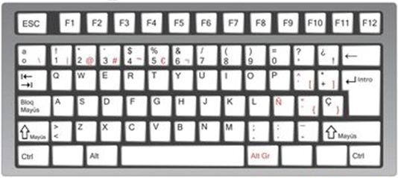
Strings and Template Literals.
const firstName = "Jonas";
const job = "teacher";
const birthYear = 1991;
const year = 2037;
const jonas = "I'm " + firstName + ", a " + (year - birthYear) + " year old " + job + "!";
console.log(jonas);
We use concatenation with strings to produce a the text output of I'm Jonas, a 46 year old teacher!
const jonasNew = `I'm ${firstName}, a ${year - birthYear} year old ${job}!`;
console.log(jonasNew);
A better way to achieve this would be using template literals. Here the variables are placed inside curly braces and preceded by a dollar sign. Note that the start and end of the string is defined by a backtick ` symbol which on a Spanish keyboard is found to the left of the P key.
console.log(`Just a regular string....`)
We also use backticks to output directly a string.

Slide 12
If Else statements.
const age = 17;
if (age >= 18) {
console.log(`Sarah can start learning to drive🚗`);
} else {
yearsLeft = 18 - age;
console.log(`Sarah can't start learning to drive for ${yearsLeft} years 🛴`);
}
Note that the else block is optional. If no else statement is present and the condition is false then JavaScript will just move onto the following line of code.
Emoji’s are found by using the windows and dot key.

Slide 13
const birthyear = 1991;
if (birthyear <= 2000) {
let century = 20;
} else {
/ let century = 21;
}
console.log(century);
}
const birthyear = 2001;
let century;
if (birthyear <= 2000) {
century = 20;
} else {
century = 21;
}
console.log(century);
Note that the variable century is defined within the if else code block and so will produce an error if we try to call it outside the if else code block.
Uncaught ReferenceError: century is not defined.
so we first need to define an empty variable outside of the if else block to be able to call century outside of the if else statement.

Slide 14
Type Conversion & Coercion
Type conversion is when we manually convert from one data type to another, I.e. String to number.
const inputYear = "1991";
console.log(inputYear + 18);
console.log(Number(inputYear) + 18);
console.log(Number("Jonas"));
console.log(String(23), 23);
console.log(typeof String(23));
The year is a string not a number because it is in quotes.
This will concatenate to give output of 199118.
Number will convert the string to a number
When a string cannot be converted to a number we get NaN – Not a Number.
We can convert a number to a string.
Type coercion is when JavaScript automatically does the type conversion behind the scenes.
console.log('I am ' + 23 + ' years old’);
console.log("23" - "10" - 3);
console.log("23" * "2");
Here JavaScript is automatically treating 23 as a string.
JavaScript does type coercion here to convert strings to numbers outputting 10.
JavaScript does type coercion here to convert both strings to numbers outputting 46.

Slide 15
What value will be logged to the screen?
let n = "1" + 1;
n = n - 1;
console.log(n);
JavaScript does type coercion to string so “1” + “1” will be 11.
Now n with a value of 11 is treated as a number so the output will be 10.
let x = 2 + 3 + 4 + “5”;
console.log(x);
JavaScript will treat 2 + 3 + 4 as a number giving a value of 9 then concatenate the 5 onto string 9 -> “95”
let y = "10" + "4" - "3" - 2 + "5";
console.log(y);
JavaScript will treat 10 - 4 - 3 as a number giving a value of 1 then concatenate the 1 onto string 5 -> “15”

Slide 16
Truthy values & Falsy Values
5 Falsy Values: Zero 0, Empty string “”, undefined, Null and NaN
console.log(Boolean(0)); // False
console.log(Boolean(undefined)); // False
console.log(Boolean("Jonas")); // True - Strings are truthy when converted to Boolean.
console.log(Boolean({})); // True
console.log(Boolean("")); // False
JavaScript performs type coercion in a Boolean operation.
const money = 0;
if (money) {
console.log("Don´t Spend it all;)");
} else {
console.log("You have no money!");
}
const money = 100;
if (money) {
console.log("Don´t Spend it all;)");
} else {
console.log("You have no money!");
}
What operation will be logged? The If or the Else?
The zero will be treated as a falsy Boolean so the else statement will be executed.
100 is a truthy Boolean so the if statement will be executed.

Slide 17
Boolean can be used to check if a variable is defined.
let height;
if (height) {
console.log('YAY! Height is defined');
} else {
console.log('Height is NOT defined');
}
let height = 0;
if (height) {
console.log('YAY! Height is defined');
} else {
console.log('Height is NOT defined');
}
let height = 10;
if (height) {
console.log('YAY! Height is defined');
} else {
console.log('Height is NOT defined');
}
Height is UNDEFINED and therefore a falsy value so the else statement will be executed.
Height is set to zero and therefore a falsy value so the else statement will be executed, even though height is defined.
Height is set to 10 and therefore a truthy value so the if statement will be executed.

Slide 18
Equality Operators == or ===
const age = 18;
if (age === 18) console.log('You Just became an adult’);
const age2 = "18";
if (age2 == 18) console.log('You Just became an adult’);
const age3 = "18";
if (age3 === 18) console.log('You Just became an adult');
=== returns a Boolean value if the results match strictly.
== returns a Boolean value if the results match. Note that this is not strict so JavaScript does type coercion.
=== returns a Boolean value if the results strictly match. Note a string and a number do not match strictly because they are different data types.
Boolean True
Boolean True
Boolean False
The loose equality operator of == can introduce a lot of unusual bugs in JavaScript so it is always better to use strict === and perform manual type conversion if needed.

Slide 19
The prompt asks the user for a number and of course we input 23.
When we run the if statement using loose equality operator == the Boolean is true.
However when we run the if statement with strict equality then the Boolean is false and it returns nothing.
This is because the user input from the prompt is treated as a string.
To get around this perform manual type conversion of the prompt into a number.
const favorite = prompt("what is your favorite number?");
console.log(favorite);
if (favorite == 23) {
console.log('Cool! 23 is an amazing number!');
}
if (favorite === 23) {
console.log('Cool! 23 is still an amazing number!');
}
console.log(typeof favorite);
const favorite2 = Number(prompt("what is your favorite number?"));
console.log(favorite2);
if (favorite2 === 23) {
console.log('Cool! 23 is still an amazing number!');
}

Slide 20
const favorite3 = Number(prompt("what is your favorite number?"));
console.log(favorite3);
if (favorite3 === 23) {
console.log('Cool! 23 is still an amazing number!');
} else if (favorite3 === 7) {
console.log('Cool! 7 is a lucky number!');
} else if (favorite3 === 9) {
console.log('Cool! 9 is the square of three!');
} else {
console.log('Number is not 7 or 23');
}
if (favorite3 !== 23) console.log('Why not 23?');
Else if can be used to add more options to the statement.
!== means not equal to (strict mode)
!= Means not equal to (loose mode)
An input of 9
Cool! 9 is the square of three!
Why not 23?
An input of 7
Cool! 7 is a lucky number!
Why not 23?
An input of 23
Cool! 23 is still an amazing number!
All other numbers
Number is not 7 or 23!
Why not 23?

Slide 21
Boolean Logic – And // Or // Not
A: Sarah has a driving license
B: Sarah has good Vision
Boolean values that can be TRUE or FALSE
A and B: Sarah has a driving license AND good vision
A or B: Sarah has a driving license OR good vision
Not A, Not B
Inverts true/false value.
AND
TRUE
FALSE
OR
TRUE
FALSE
TRUE
TRUE
FALSE
TRUE
TRUE
TRUE
FALSE
FALSE
FALSE
FALSE
TRUE
FALSE
Truth table for AND
Truth table for OR
True when ALL are true
True when ONE is true
No matter how many variables

Slide 22
A:
Boolean Variables that can be TRUE or FALSE
AND
TRUE
FALSE
A: Age is greater than or equal to 20
B: Age is less than 30
FALSE
Age = 16
B:
TRUE
TRUE
FALSE
TRUE
FALSE
FALSE
FALSE
JavaScript Operators
A:
(Not A)
!A
=
TRUE
A Or !B
OR
TRUE
FALSE
=
FALSE
FALSE
FALSE
FALSE
B:
TRUE
TRUE
TRUE
A and B
!A and B
FALSE
TRUE
=
FALSE
TRUE
TRUE
=
TRUE
FALSE
TRUE
FALSE
A or B
FALSE
TRUE
=
TRUE

Slide 23
Logical Operators
&& = And
|| = Or
! = Not
const hasDriversLicense = true;
const hasGoodVision = true;
console.log(hasDriversLicense && hasGoodVision);
console.log(hasDriversLicense || hasGoodVision);
console.log(!hasDriversLicense);
const shouldDrive = hasDriversLicense && hasGoodVision;
if (hasDriversLicense && hasGoodVision) {
console.log("Sarah is able to drive!")
} else {
console.log("someone else should drive....")
}
const isTired = true;
console.log(hasDriversLicense && hasGoodVision && isTired);
if (hasDriversLicense && hasGoodVision && !isTired) {
console.log("Sarah is able to drive!")
} else {
console.log("someone else should drive....")
}
Variable A Variable B
Varible C

Slide 24
The Switch Statement
const day = "monday";
switch (day) {
case 'monday':
console.log('Plan Course Structure');
console.log('Go to coding meetup');
break;
case 'tuesday':
console.log('Prepare theory videos');
break;
case 'wednesday':
case 'thursday':
console.log('write code examples');
break;
case 'friday':
console.log('Record Videos');
break;
case 'saturday':
case 'sunday':
console.log('Enjoy the weekend');
break;
default:
console.log('not a valid day!');
}
The switch statement is like a string of If else statements.
We define the true condition with a case, followed by the code we want to operate then a break.
Default is used at the end to cover a scenario where none of the cases match the true clause.

Slide 25
const dayOfWeek = 'Saturday';
if (dayOfWeek === 'Monday') {
console.log('Plan Course Structure');
console.log('Go to coding meetup');
} else if (dayOfWeek === 'Tuesday') {
console.log('Prepare theory videos');
} else if ((dayOfWeek === 'Wednesday') || (dayOfWeek === 'Thursday')) {
console.log('write code examples');
} else if (dayOfWeek === 'Friday') {
console.log('Record Videos');
} else if ((dayOfWeek === 'Saturday') || (dayOfWeek === 'Sunday')) {
console.log('Enjoy the weekend');
} else {
console.log('not a valid day!');
}
The switch statement written as If else would be something like this.

Slide 26
Statements & Expressions
An Expression is a line of code that produces a value. For example:
The expression is 3 + 4.
3 + 4
True && false && !true
1991
A Statement is an action to be performed, like a complete sentence.
if (23 > 10) {
const str = "23 is bigger";
}
This is important because JavaScript expects statements and expressions in certain places. For example we cannot insert a statement in a template literal.
const me = 'Jonas'
console.log(`i'm ${2037 - 1991} years old and my name is ${me}`)
console.log(`i'm ${if (23 > 10) { const str = "23 is bigger"; }}`)
We can insert variables and values into the template literal because they are expressions.
But we cannot insert an if statement into a template literal.

Slide 27
The Conditional Ternary Operator
The ternary operator can be used to replace an if else with one line of code. It is called a ternary operator because it has 3 parts.
const age = 19;
age > 18 ? console.log('I drink wine🍷') : console.log('I drink water🥛');
Condition
(age is greater than 18)
True expression
false expression
Condition ? True expression : false expression
Conditional ternary operators are really useful for declaring a variable and a lot shorter than writing a full if else statement.
let drink2;
if (age <= 18) {
drink2 = 'wine🍷';
} else {
drink2 = 'water🥛';
}
console.log('I like to drink ' + drink2)
const drink = age > 18 ? 'wine🍷' : 'water🥛';
console.log('I like to drink ' + drink)
Additionally, because a ternary operator is an expression it can be inserted into a template literal.
console.log(`I like to drink ${age > 18 ? 'wine🍷' : 'water🥛'}`);
Ternary operator is not a replacement for if else but a substitution for a quick calculation for two options.

Slide 28
JavaScript Releases: ES5, ES6+ and ESNext
1995
Brendan Eich creates the very first version of JavaScript in just 10 days for Netscape, It was called Mocha but already had many fundamental features of modern JavaScript.
1996
Mocha changed to liveScript then JavaScript in order to attract java developers. However JavaScript has nothing to do with Java.
1997
Microsoft launches IE copying JavaScript from Netscape and calling it jScript.
1997
Not a good idea to have two versions of a similar language so ECMA releases ECMAscript (ES1), the first official standard for JavaScript. (ECMA is the standard, Javascript is the language in practice.
2007
ES5 (ECMAscript 5) was released with plenty of cool new features.
2015
ES6 (ECMAscript 2015) was released with the biggest update to features.
2016 ∞
ES2016, ES2017, ES2018, ES2019, ES2020, ES2021, ES2022. ECMAscript changes to an annual release cycle for new features to ship less features per update.

Slide 29
JavaScript has full backwards compatibility. If we take code written in 1997 then it will still work today in the browser.
The guiding principle behind this is to not break the web. Websites keep working forever.
Forwards compatibility: If we take code written in 2009 and try and run it in a browser from 1997 then it will not work!
How can we use JavaScript today when coding for possible users that have an outdated browser?
Well as a developer all we have to do is use the most up to date version of a browser with dev tools.
When we finish the code we can use a tool like babel to transpile and polyfill the code converting it back to an ES5 version to ensure most browser compatibility for must users.
ES5
Fully supported in all browsers back to IE9 from 2011 → Ready to be used today.
ES6
ES2022
ES6+ Fully supported in most modern browsers
No support in older browsers
→ Can use most features with transpilling and pollyfilling
ES2022 ∞
Esnext New versions of the language (new feature proposals that reach stage 4)
→ Can already use SOME features in production with transpilling and pollyfilling
https://kangax.github.io/compat-table/es6/
https://kangax.github.io/compat-table/es2016plus/

Slide 30
JAVASCRIPT FUNDAMENTALS PART 2

Slide 31
Activating Strict Mode in JavaScript
Strict Mode allows us to write better, more secure, less buggy JavaScript code.
'use strict’; Enable strict mode with use strict command.
This command takes effect for all lines of JavaScript code below the use strict line so it is important that this appears at the very top of our JavaScript file.
Strict mode prohibits us from doing certain things and also shows errors in our code that may otherwise be silent errors.
let hasDriversLicense = false;
const passTest = true;
if (passTest) hasDriverLicense = true;
if (hasDriversLicense) console.log('I can drive!’);
'use strict';
let hasDriversLicense = false;
const passTest = true;
if (passTest) hasDriverLicense = true;
if (hasDriversLicense) console.log('I can drive!');
Note in the first if statement that the variable hasDriversLicense is spelled wrong. Without strict mode enabled this will produce a silent error because the second if statement will not be executed. Console log will be blank.
But with strict mode it throws an error. “Uncaught ReferenceError: hasDriverLicense is not defined”

Slide 32
Strict Mode also protects us from using possible future protected words or actual protected words.
'use strict’;
const interface = 'Audio’; Uncaught SyntaxError: Unexpected strict mode reserved word
const private = 1; Uncaught SyntaxError: Unexpected strict mode reserved word
const if = 10; Uncaught SyntaxError: Unexpected token 'if'
Interface and private are protected words that are reserved for future JavaScript features and If is a protected word that cannot be used for a variable name.

Slide 33
JavaScript Functions
A function is a block of code that we can reuse multiple times in our project to keep the code DRY – Don’t Repeat yourself!
function logger() {
console.log('my name is Jonas');
}
logger();
logger();
logger();
We have a function called logger which performs a console log of a text string. We can then call or run or invoke that function multiple times, in this case three times.
my name is Jonas script.js:19
my name is Jonas script.js:19
my name is Jonas script.js:19
We have a fruit processor function that returns apple and orange juice.
function fruitProcessor(apples, oranges) {
const juice = `juice with ${apples} apples and ${oranges} oranges.`;
return juice;
}
const appleJuice = fruitProcessor(5, 0);
console.log(appleJuice);
const orangeJuice = fruitProcessor(0, 2);
console.log(orangeJuice);
const mixedJuice = fruitProcessor(1, 1);
console.log(mixedJuice);
We can use that function to call an apple juice from 5 apples!
We can use that function to run an orange juice from 2 oranges!
We can use that function to invoke an orange and apple juice from 1 apple and 1 orange!

Slide 34
JavaScript Function Declarations vs Expressions
The food processor was a function declaration where we simply declare it as a function
function calcAge1(birthYear) {
return 2037 - birthYear;
}
const age1 = calcAge1(1991);
console.log(age1);
const calcAge2 = function (birthYear) {
return 2037 - birthYear;
}
const age2 = calcAge2(1991);
console.log(age2);
CalcAge1 is also a function declaration where we have a placeholder called birthyear that we can insert values into when we call that function.
CalcAge2 is also function expression or anonymous function where we define a variable as a function then invoke that variable latter.
Remember that expressions produce values to the variable calcAge2 just holds a value such as a number, string or Boolean.

Slide 35
We can call function declarations BEFORE the are defined in the code whereas function expressions cannot be called before they are written in the code. This is due to Hoisting which will be covered in a future lesson.
const age3 = calcAge1(1991);
console.log(age3);
// function declaration
function calcAge1(birthYear) {
return 2037 - birthYear;
}
const age4 = calcAge2(1991);
console.log(age4);
// function expression
const calcAge2 = function (birthYear) {
return 2037 - birthYear;
}
Uncaught ReferenceError: Cannot access 'calcAge2' before initialization
What type of function should be used? Function declaration or Function expression? Well function expression forces you to define all the functions at the top of the code with clearly defined variables but it is really down to personal choice.

Slide 36
Arrow Function (new in Javascript ES6)
const calcAge3 = birthYear => 2037 - birthYear;
const age5 = calcAge3(1991);
console.log(age5);
const yearsUntilRetirement = birthYear => {
const age = 2037 - birthYear;
const retirement = 65 - age;
return retirement;
}
console.log(yearsUntilRetirement(1991));
const yearsUntilRetirement = (birthYear, firstName) => {
const age = 2037 - birthYear;
const retirement = 65 - age;
return `${firstName} retires in ${retirement} years`;
}
console.log(yearsUntilRetirement(1991, 'Jonas'));
console.log(yearsUntilRetirement(1980, 'Bob'));
An arrow function is a shorthand way of writing a function expression with the return implicitly running.
If we want the arrow to perform multiple calculations then we need the curly braces.
We can pass multiple parameters into an arrow function but we must wrap them in brackets and separated by a coma.

Slide 37
Functions calling other functions
// The fruit dicer chops fruit into four chunks
function diceFruit(fruit) {
return fruit * 4;
}
// The fruit processor can only make juice from diced fruit
function fruitProcessor(apples, oranges) {
const dicedApple = diceFruit(apples);
const dicedOrange = diceFruit(oranges);
const juice = `juice of ${dicedApple} apple chunks and ${dicedOrange} orange chunks.`;
return juice;
}
console.log(fruitProcessor(2, 5));
3) The diceFruit function dices the fruit into 4 chunks
2) 2 apples get diced by the external diceFruit function.
4) 5 oranges get diced by the external diceFruit function.
5) The fruitProcessor returns juice containing many chunks of fruit.
1) We pass into the fruitProcessor 2 apples and 5 oranges.
This is a good example of DIY. Don’t repeat yourself because we are dicing two fruit into 4. if we were fruitProcessing 10 items of fruit then we would still only need one diceFruit Function.

Slide 38
Review Functions
To convert an arrow function into a function Expression we just remove the arrow and add function before the input params.
function
X
const yearsUntilRetirement = (birthYear, firstName) => {
const age = 2037 - birthYear;
const retirement = 65 - age;
return `${firstName} retires in ${retirement} years`;
}
const calcAge = function (birthYear) {
return 2037 - birthYear;
}
const yearsUntilRetirement = function (birthYear, firstName) {
const age = calcAge(birthYear);
const retirement = 65 - age;
return `${firstName} retires in ${retirement} years`;
}
console.log(yearsUntilRetirement(1991, 'Jonas'));
console.log(yearsUntilRetirement(1970, 'Bob'));
Now the age is calculated in a separate function called calc age. We call the calcAge function from within the yearsUntilRetirement function.

Slide 39
Now with a birth year of 1970, bob is already retired by -2 years. We can account for that with an if else statement to return either retirement variable or -1 if retirement is not greater than zero.
Note that after the return there is an explicit exit. i.e. it does not run any more of the function code.
const calcAge = function (birthYear) {
return 2037 - birthYear;
}
const yearsUntilRetirement = function (birthYear, firstName) {
const age = calcAge(birthYear);
const retirement = 65 - age;
if (retirement > 0) {
return retirement;
} else {
return -1;
}
}
console.log(yearsUntilRetirement(1991, 'Jonas'));
console.log(yearsUntilRetirement(1970, 'Bob'));

Slide 40
If I now add a console log after each of the return lines will it show in the browser? No – because it is after the return which has an explicit exit so the console log line is simply ignored.
const yearsUntilRetirement = function (birthYear, firstName) {
const age = calcAge(birthYear);
const retirement = 65 - age;
if (retirement > 0) {
return retirement;
console.log(`${firstName} retires in ${retirement} years`);
} else {
return -1;
console.log(`${firstName} is already retired`);
}
}
console.log(yearsUntilRetirement(1991, 'Jonas'));
console.log(yearsUntilRetirement(1970, 'Bob'));

Slide 41
In Visual studio code you can highlight the line and use alt and up arrow to move the highlighted line up 1. Now we see the console.log is before the return so it will be executed.
const calcAge = function (birthYear) {
return 2037 - birthYear;
}
const yearsUntilRetirement = function (birthYear, firstName) {
const age = calcAge(birthYear);
const retirement = 65 - age;
if (retirement > 0) {
console.log(`${firstName} retires in ${retirement} years`);
return retirement;
} else {
console.log(`${firstName} is already Retured`);
return -1;
}
}
console.log(yearsUntilRetirement(1991, 'Jonas'));
console.log(yearsUntilRetirement(1970, 'Bob'));

Slide 42
Function Declaration, can be used before it is declared.
// Function Declaration
function calcAge (birthYear) {
return 2037 - birthYear;
}
// Function Expression
const calcAge = function (birthYear) {
return 2037 - birthYear;
}
// Arrow Function
const calcAge = birthYear => 2037 - birthYear;
Function Expression, essentially a function stored inside a variable
Arrow Function, good for quick one line functions. Has no This keyword. More about this later.
All three types of function work in the same way, they receive input data, transform the data and then output the data.

Slide 43
Parameter names. These are placeholders for the parameters we input into the function.
Function name
const yearsUntilRetirement = (birthYear, firstName) => {
const age = 2037 - birthYear;
const retirement = 65 - age;
return `${firstName} retires in ${retirement} years`;
}
console.log(yearsUntilRetirement(1991, 'Jonas'));
console.log(yearsUntilRetirement(1980, 'Bob'));
We call or invoke or run the function with parenthesis (), In this case we are calling the function with two parameters inside the parenthesis.

Slide 44
Introduction to Arrays
An array is a means to store multiple values of the same thing i.e. friends or years, rather than a variable for each one.
const friend1 = 'Michael';
const friend2 = 'Steven';
const friend3 = 'Peter';
// Create array using littoral syntax
const friendArr = ['Michael', 'Steven', 'Peter'];
console.log(friendArr);
// Create array using the inbuilt array function
const yearsArr = new Array(1991, 1984, 2008, 2020);
console.log(yearsArr);
// retrieve a value from within the array
console.log(friendArr[0], yearsArr[2]);
// To determine array length
console.log(friendArr.length);
// To get the last value from the array
console.log(friendArr[friendArr.length-1]);
An array can be defined by using the littoral method or the inbuilt array function.
The position of values in ana array start from zero. i.e. the first value in the array is [0], the second position in the array is [1], third position [2], etc….
Array.length will always output the length counting from 1, i.e. the quantity of values inside the array.
Because the values in the array are numbered from zero the last value in the array will be length minus 1.

Slide 45
We can overwrite a position in an array with a new value by specifying it’s position number starting from zero.
// Mutate array by replacing Peter with Jay
friendArr[2] = 'Jay';
console.log(friendArr);
// We cannot overwrite the contents of the entire array
friendArr = ['Bob', 'Alice’];
Uncaught TypeError: Assignment to constant variable.
// We can populate an array with any data type. string, number etc..
const personArr = ['Jonas', 'Schmedtmann', 2037-1991];
console.log(personArr);
// We can insert variables into an array
const firstName = 'Jonas';
const lastname = 'Schmedtmann';
const age = 2037-1991;
const varArr = [firstName, lastname, age];
console.log(varArr);
But we cannot overwrite the entire contents of the array. This is illegal.
An array can be populated with more than one data type.
Variables can even be inserted into an array.

Slide 46
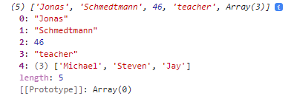
// An array can be inserted into an array
const profession = 'teacher';
const multiArr = [firstName, lastname, age, profession, friendArr];
console.log(multiArr);
Note how the array length is 5. [0] is firstName, [1] is lastName, [2] is age, [3] is profession and [4] is the friendArr. This array contains a total of five values with the fifth value being an array.
const calcAge = function (birthYear) {
return 2037 - birthYear;
}
const yearArr = [1990, 1967, 2002, 2010, 2018];
console.log(calcAge(yearArr));
const age1 = calcAge(yearArr[0]);
const age2 = calcAge(yearArr[1]);
const age3 = calcAge(yearArr[yearArr.length-1]);
console.log(age1, age2, age3);
const agesArr = [calcAge(yearArr[0]), calcAge(yearArr[2]), (yearArr[yearArr.length-1])];
console.log(agesArr);
If I try and run an array through a function I get a NaN error, Not a number.
But I can run individual values from the array through the function.
I can create an array based on values created from a function by calling that function from within the array.

Slide 47
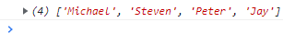
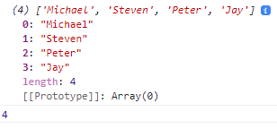
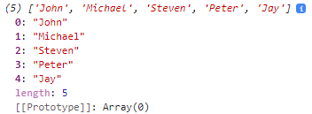
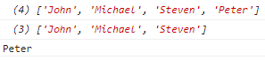
Basic Array Operations (Methods)
Push adds an element onto the end of the array
const friendArr = ['Michael', 'Steven', 'Peter'];
friendArr.push('Jay');
console.log(friendArr);
Push is also a function which returns array length by default so we can put this in a variable.
const friendArr = ['Michael', 'Steven', 'Peter'];
const newLength = friendArr.push('Jay');
console.log(friendArr);
console.log(newLength);
Unshift method adds elements to the beginning of the array
friendArr.unshift('John');
console.log(friendArr);
Pop will remove the LAST element of the array
friendArr.pop();
console.log(friendArr);
It does not return the length of the array but returns what was popped
const popped = friendArr.pop();
console.log(friendArr);
console.log(popped);

Slide 48
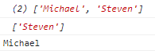
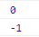
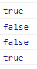
SHIFT Removes First element from the array
friendArr.shift();
console.log(friendArr);
It does not return the length of the array but returns what was shifted
const shifted = friendArr.shift();
console.log(friendArr);
console.log(shifted);
Find index of an element in array (The position starting from zero)
console.log(friendArr.indexOf('Steven'));
If we try and look for an element which is not in the array we will get -1 as a result.
console.log(friendArr.indexOf('Micahel’));
Modern Es6 method for indexOf is includes which returns a Boolean if element is in array
console.log(friendArr.includes('Steven'));
console.log(friendArr.includes('Micahel'));
Includes uses strict mode so does not do type coercion
If I add 23 as a number then try and find it as a string
friendArr.push(23);
console.log(friendArr.includes('23'));
console.log(friendArr.includes(23));

Slide 49

We can use includes to write conditionals
if (friendArr.includes('Peter')) {
console.log('you have a friend called Peter');
} else {
console.log('Peter is not your friend');
}

Slide 50
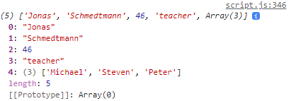
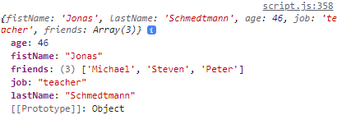
Introduction to Objects
Here we have a person array with elements in it, but we can only reference those elements by calling their position (starting from zero).
const personArr = [
'Jonas',
'Schmedtmann',
2037-1991,
'teacher',
['Michael', 'Steven', 'Peter']
];
console.log(personArr);
But we can assign a name to each element in the object array using curly braces to make key value pairs.
const personObj = {
firstName: 'Jonas',
lastName: 'Schmedtmann',
age: 2037-1991,
job: 'teacher',
friends: ['Michael', 'Steven', 'Peter']
}
console.log(personObj);
The object of PersonObj has 5 properties - firstName, lastName etc... Using curly braces to write an object is called the object literal. Note how the object is ordered alphabetically in the console.

Slide 51
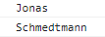
Dot vs Bracket notation
Retrieving a value by property name from an object using dot notation
console.log(personObj.firstName);
Retrieving a value by property name from an object using brackets
console.log(personObj['lastname']);
Using square brackets we can concatenate
const nameKey = 'Name';
console.log(personObj['first' + nameKey]);
console.log(personObj['last' + nameKey]);
But using dot notation to compute using concatenation does not work
console.log(personObj.'last' + nameKey);
Uncaught SyntaxError: Unexpected string
We can use the function prompt to define a variable of what property we want to find.
const tellMe = prompt('What do you want to know about personObj? Choose between firstName, LastName, age, job and friends’);
Then use the bracket notation to output the contents of the object property.
console.log(personObj[tellMe]);

Slide 52
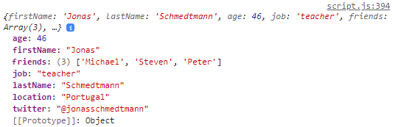
But what if the user enters a falsy value that is not a property?
const tellMe = prompt('What do you want to know about personObj? Choose between firstName, LastName, age, job and friends');
if (personObj[tellMe]) {
console.log(personObj[tellMe]);
} else {
console.log('Wrong Request! Choose between firstName, LastName, age, job and friends');
}
We can add new properties to the object using the dot notation or the bracket notation.
personObj.location = 'Portugal';
personObj['twitter'] = '@jonasschmedtmann';
console.log(personObj);

Slide 53
Challenge: Compute string ‘Jonas has 3 friends and his best friend is called michael’ using arrays.
const personObj = {
firstName: 'Jonas',
lastName: 'Schmedtmann',
age: 2037-1991,
job: 'teacher',
friends: ['Michael', 'Steven', 'Peter']
}
console.log(personObj);
Option 1
const FistName = personObj.firstName;
const bestFriend = personObj.friends[0];
const totalFriends = personObj.friends.length;
console.log(FistName + ' Has ' + totalFriends + ' friends and his best friend is called ' + bestFriend);
Option 2
console.log(`${personObj.firstName} has ${personObj.friends.length} friends and his best friend is called ${personObj.friends[0]}`);
https://developer.mozilla.org/en-US/docs/Web/JavaScript/Reference/Operators/Operator_Precedence
In the operator precedence ‘member access’ has a high precedence and associativity of left to right which is why we are able to go into the friends array of the personObj.

Slide 54
Object Methods
Objects like arrays can hold different types of data, they can even hold arrays. THey can even hold objects inside of objects. Functions are just like another type of property because they hold values.
Any function attached inside an object is called a method. But the function must be an expression.
const personObj = {
firstName: 'Jonas',
lastName: 'Schmedtmann',
birthYear: 1991,
job: 'teacher',
friends: ['Michael', 'Steven', 'Peter'],
hasDriversLicense: true,
calcAge: function(birthYear) {
return 2037 - birthYear;
}
};
We can call the method in the object using dot or bracket notation
console.log(personObj.calcAge(1991));
console.log(personObj['calcAge'](1991));

Slide 55
But we are inputting the birthYear when it is already in the object.
const personObj = {
firstName: 'Jonas',
lastName: 'Schmedtmann',
birthYear: 1991,
job: 'teacher',
friends: ['Michael', 'Steven', 'Peter'],
hasDriversLicense: true,
calcAge: function() {
console.log(this);
return 2037 - this.birthYear;
}
};
We can call the method in the object using dot notation
console.log(personObj.calcAge());
The THIS keyword refers to this object so by using it we are saying console.log this object or birthyear from this object.
Instead of the this keyword we could use personObj but what if we latter rename the object to something like personObj2? Well it would not work anymore so always use this keyword!

Slide 56
But what if we need to call the age more than once in our code?
We would be running the method within the object multiple times which could slow down our code if the method is doing complex calculations.
Better to calculate the age once and store it as a new property so that it only gets calculated once.
const personObj = {
firstName: 'Jonas',
lastName: 'Schmedtmann',
birthYear: 1991,
job: 'teacher',
friends: ['Michael', 'Steven', 'Peter'],
hasDriversLicense: true,
calcAge: function() {
this.age = 2037 - this.birthYear;
return this.age;
}
};
console.log(personObj.calcAge());
console.log(personObj.age);
console.log(personObj.age);
console.log(personObj.age);

Slide 57
Challenge: "Jonas is a 46 year old teacher and he has a drivers License OR has no drivers License"
const personObj = {
firstName: 'Jonas',
lastName: 'Schmedtmann',
birthYear: 1991,
job: 'teacher',
friends: ['Michael', 'Steven', 'Peter'],
hasDriversLicense: false,
calcAge: function() {
this.age = 2037 - this.birthYear;
return this.age;
},
getSummary: function () {
return `${this.firstName} is a ${this.calcAge()} year old ${this.job} and ${this.hasDriversLicense ? "has a drivers license." : "doesn't have a drivers license."}`;
}
};
console.log(personObj.calcAge());
console.log(personObj.getSummary());

Slide 58
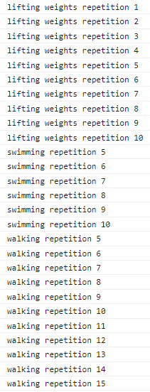
Iteration – For loop
Loops are fundamental to coding. They are used for when we have to repeat something multiple times.
For loop has three components:
1. define variable and set initial value
2. for loop keeps running while condition is true
3. Increment counter
for (let rep = 1; rep <= 10; rep++) {
console.log(`lifting weights repetition ${rep}`);
}
for (let rep = 5; rep <= 10; rep++) {
console.log(`swimming repetition ${rep}`);
}
for (let rep = 5; rep <= 15; rep++) {
console.log(`walking repetition ${rep}`);
}

Slide 59
Looping arrays, breaking and Continuing
We have an array with five elements in it.
const personObj = [
'Jonas',
'Schmedtmann',
1991,
'teacher',
['Michael', 'Steven', 'Peter']
];
We want to loop through all the elements one by one.
1. We start the array at 0 because that is the first element in the array
2. We want to stop looping at 5 (because the array contains five elements)
3. Each time through the loop we increment by 1.
for (let i = 0; i<5 ; i++) {
console.log(personObj[i]);
}

Slide 60
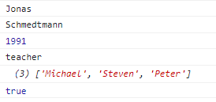
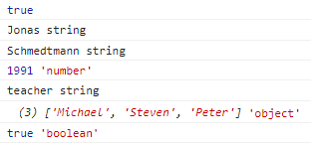
We have an array with six elements in it.
const personObj2 = [
'Jonas',
'Schmedtmann',
1991,
'teacher',
['Michael', 'Steven', 'Peter'],
true
];
But because we have manually defined the condition to be less than 5 it will not iterate through element 6 in the array.
We can dynamically calculate the array length by using built in length function!
for (let i = 0; i<personObj2.length ; i++) {
console.log(personObj2[i]);
}
for (let i = 0; i<personObj2.length ; i++) {
console.log(personObj2[i], typeof personObj2[i]);
}

Slide 61
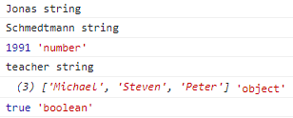

const personObj2 = [
'Jonas',
'Schmedtmann',
1991,
'teacher',
['Michael', 'Steven', 'Peter'],
true
];
We can create a new empty array outside of the loop
const types = [];
for (let i = 0; i<personObj2.length ; i++) {
Here we are reading the array for each element and getting the typeof
console.log(personObj2[i], typeof personObj2[i]);
Here we are filling the types array with typeof for each i.
types[i] = typeof personObj2[i];
}
console.log(types);

Slide 62
The same operation can be done with an array push
const types = [];
for (let i = 0; i<personObj2.length ; i++) {
console.log(personObj2[i], typeof personObj2[i]);
types.push(typeof personObj2[i]);
}
console.log(types);
We have an array of birthYears and we want to calculate ages and store it in a new array.
const birthYearArr = [1991, 2007, 1969, 2020];
const ageArr = [];
for (let i=0; i<birthYearArr.length; i++) {
ageArr.push(2037 - birthYearArr[i]);
}
console.log(ageArr);

Slide 63
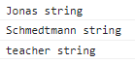
Continue and break statements
Continue is used to skip an iteration in the loop
Break is used to completely stop the loop
const personObj2 = [
'Jonas',
'Schmedtmann',
1991,
'teacher',
['Michael', 'Steven', 'Peter'],
true
];
for (let i=0; i<personObj2.length; i++) {
if (typeof personObj2[i] !== 'string') continue;
console.log(personObj2[i], typeof personObj2[i]);
}
Here we use an if statement to check if type of iteration is not a string and we skip it (continue)

Slide 64
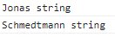
Continue and break statements
Continue is used to skip an iteration in the loop
Break is used to completely stop the loop
const personObj2 = [
'Jonas',
'Schmedtmann',
1991,
'teacher',
['Michael', 'Steven', 'Peter'],
true
];
for (let i=0; i<personObj2.length; i++) {
if (typeof personObj2[i] === 'number') break;
console.log(personObj2[i], typeof personObj2[i]);
}
Here we use an if statement to check if type of iteration a number and we stop the loop (break) at that iteration.

Slide 65
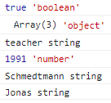
Looping backwards
To loop through an array backwards we need to modify the three parts to the for loop.
START: In this case the array has indexes of 0,1,2,3,4,5 so we want to start the loop at index five which is the length of the array minus 1.
CONDITION: We want to stop the loop when it gets to zero so the condition is going to be that I is equal to or greater than 0.
ITERATION: Finally, we want the loop to decrement by 1 the counter each iteration.
const personObj2 = [
'Jonas',
'Schmedtmann’,
1991,
'teacher',
['Michael', 'Steven', 'Peter'],
true
];
for (let i=personObj2.length-1; i>=0; i--) {
console.log(personObj2[i], typeof personObj2[i]);
}
START CONDITION ITERATION

Slide 66
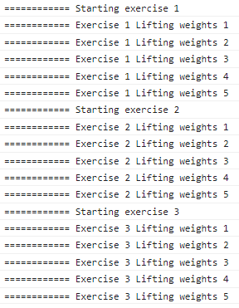
Loops within Loops
We have a routine of three exercises with each exercise being repeated (or looped 5 times)
for (let exercise = 1; exercise < 4; exercise++) {
console.log(`============ Starting exercise ${exercise}`);
for (let rep = 1; rep < 6; rep++) {
console.log(`============ Exercise ${exercise} weights repetition ${rep}`)
}
}
1)
4)
2)
4)
3)
1) We first define the outer loop with the three parameters of STARTING, CONDITION and COUNTER.
2) Within the outer loop we define the inner loop, also with starting, condition and counter.
3) On each go around of the outer loop the inner loop is executed.
4) Pay particular attention to the placement of opening and closing brackets for the outer loop.

Slide 67
The While Loop
A for loop has 3 components: Start, Condition and counter.
for (let rep = 1; rep <= 10; rep++) {
console.log(`Lifting weights repetition ${rep}`);
}
A while loop only has one component, a condition and will run until the condition is not met. However we still need to define start of the loop and counter. We define the start of the loop outside and before the loop. The counter we increment after the loop has performed its action but within the loop curly braces.
let rep = 1;
while (rep <=10) {
console.log(`swimming repetition ${rep}`);
rep ++;
}
A while loop is more versatile than a for loop because it only needs a condition. It can be used in a larger variety of situations because it does not need a counter. The condition is essential to keep it running bit the counter is not always needed.

Slide 68
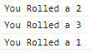
DICE ROLL WHILE LOOP: the dice will continue to roll until it lands on 6.
let dice = Math.trunc(Math.random() * 6) + 1;
while (dice !==6) {
console.log(`You Rolled a ${dice}`);
}
WHILE LOOPS CAN BE DANGEROUS: the current code will crash the browser because the while loop will run forever.
let dice = Math.trunc(Math.random() * 6) + 1;
while (dice !==6) {
console.log(`You Rolled a ${dice}`);
dice = Math.trunc(Math.random() * 6) + 1;
}
We need to reassign the dice value after each iteration of the loop to prevent infinite looping.
Lets analyse what is happening. The dice is rolled and value 2 is randomly calculated. This is not a six so we reassign the dice value and roll the dice again getting 3. We randomly reassign the dice number and roll again getting 1. Next roll we land on 6 so the loop is stopped. Note that we need to reassign the dice number after each roll because we did not specify a starting value outside of the loop.

Slide 69
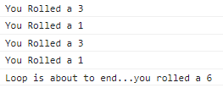
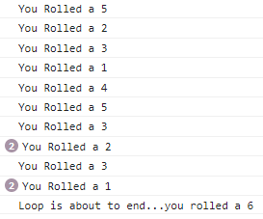
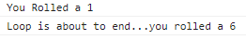
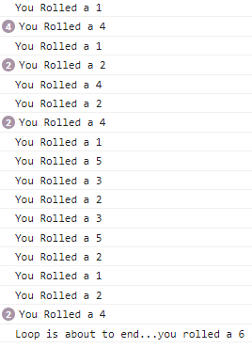
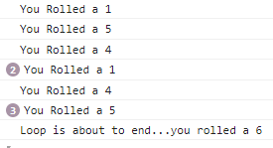
let dice = Math.trunc(Math.random() * 6) + 1;
while (dice !==6) {
console.log(`You Rolled a ${dice}`);
dice = Math.trunc(Math.random() * 6) + 1;
if (dice === 6) console.log('Loop is about to end...you rolled a 6');
}
Now each time we run this it will randomly roll the dice each time in the while loop until a 6 is found.

Slide 70
DEVELOPER SKILLS & VS CODE SETUP

Slide 71
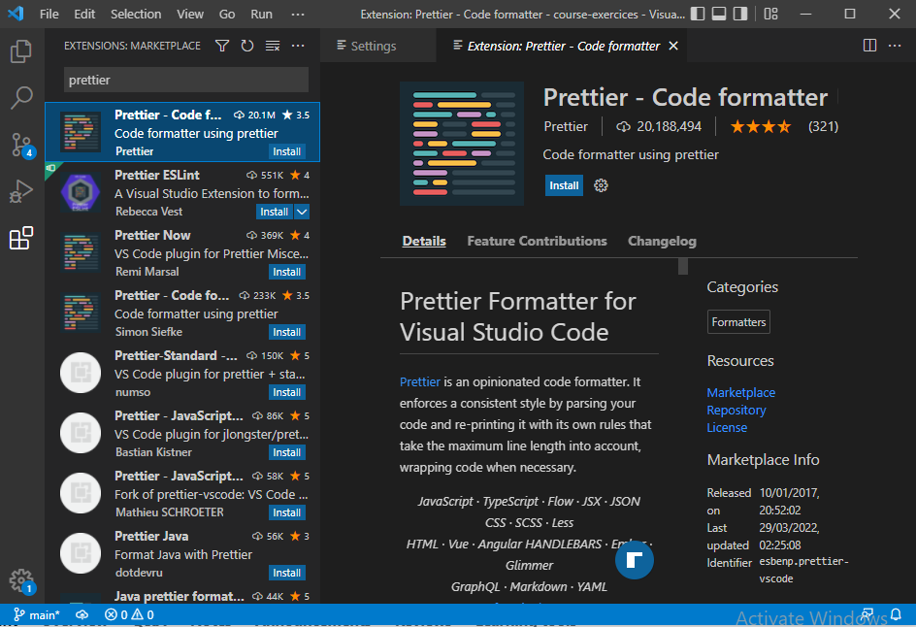
We can install prettier into vs code and restart it. This automatically format our code according to coding conventions.

Slide 72
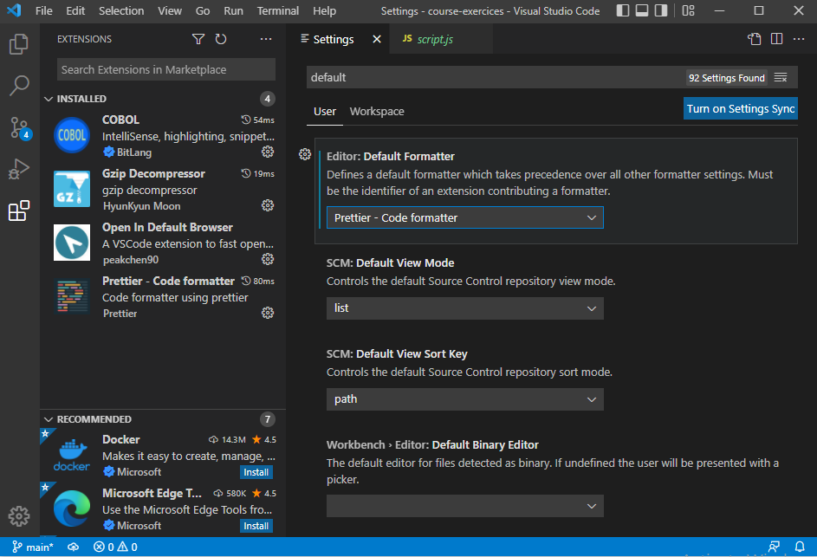
Activate prettier as the default formatter in settings.

Slide 73
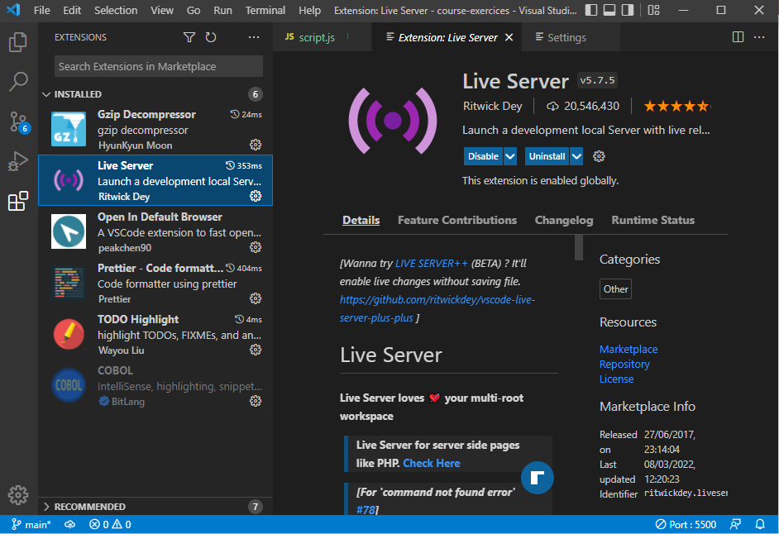
Install Live server. This will automatically reload the browser on code changes. Use the go live button at the bottom of the page.

Slide 74
Debugging
Identify
Find
Fix
Prevent
Becoming aware that there is a bug
Isolating where exactly the bug is happening in the code
Correct the code
Prevent it from happening again.
Replace wrong solution with correct solution
During Development
Testing Software
User Reports During production
Context: browsers, users etc.
Searching for same bug in similar code
Writing tests using testing software.
Developer Console (simple Code)
Debugger (complex code)

Slide 75
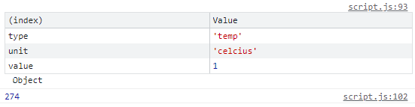
////// DEBUGGING //////
// Lets say that from our previous temperature example we need to work in kelvins.
const Measkelvin = function () {
const measmt = {
type: 'temp',
unit: 'celcius',
// C - FIX
value: Number(prompt('Degrees celcius:')),
// value: prompt('Degrees celcius:')
};
// console.log(measmt);
console.table(measmt);
// console.log(measmt.value);
// console.warn(measmt.value);
// console.error(measmt.value);
const kelvin = measmt.value + 273;
return kelvin;
};
// A) IDENTIFY
console.log(Measkelvin());
The console has various output options such as a plain log or table to help with debugging.
A good method is to put the variable into console table or log to see if it is an array, number, string etc.
In this example the prompt was returning 10 as a string when it needed to be a number to enter the Celsius to degrees conversion.

Slide 76
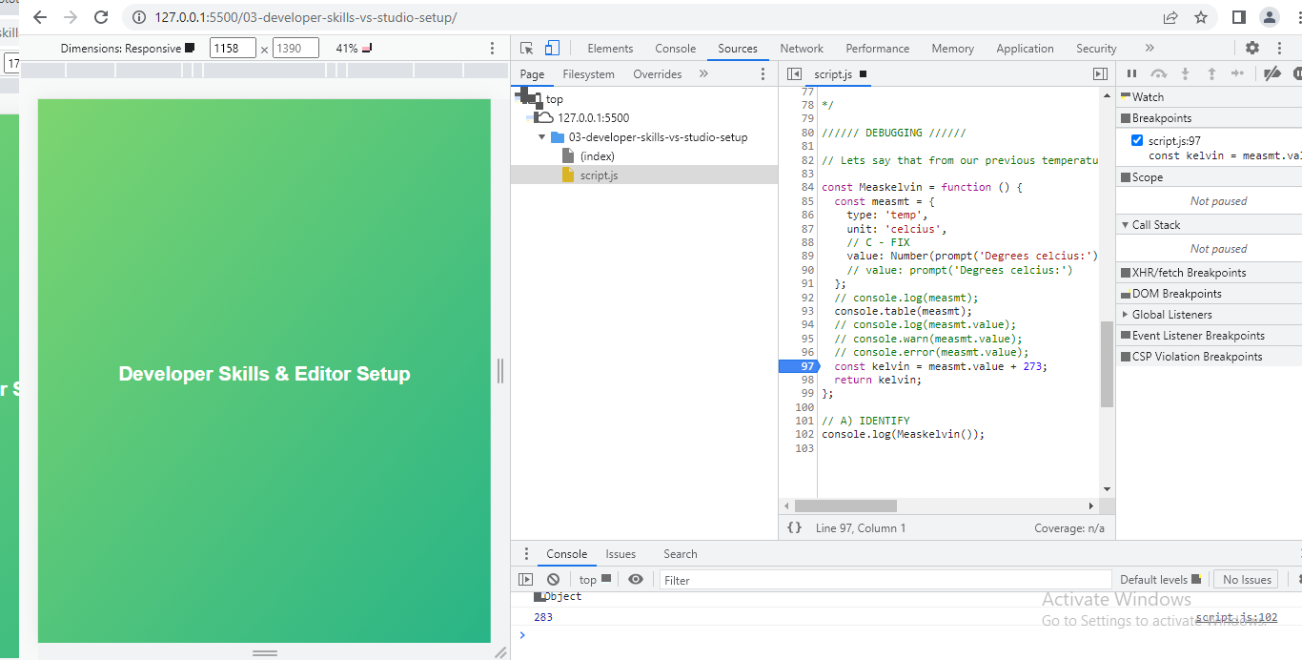
In the dev tools of chrome, we can go to sources and select our JS file. In the lines of code we can click in the left margin to insert a breakpoint.

Slide 77
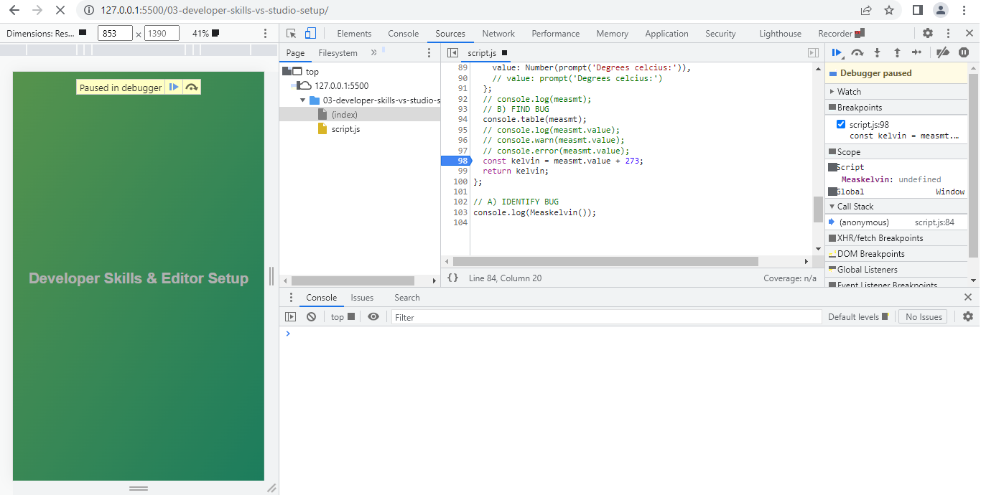
If we reload the page with the breakpoint we can see a button called debugger paused. When we press this button the code will resume execution from the beginning up to the breakpoint.

Slide 78
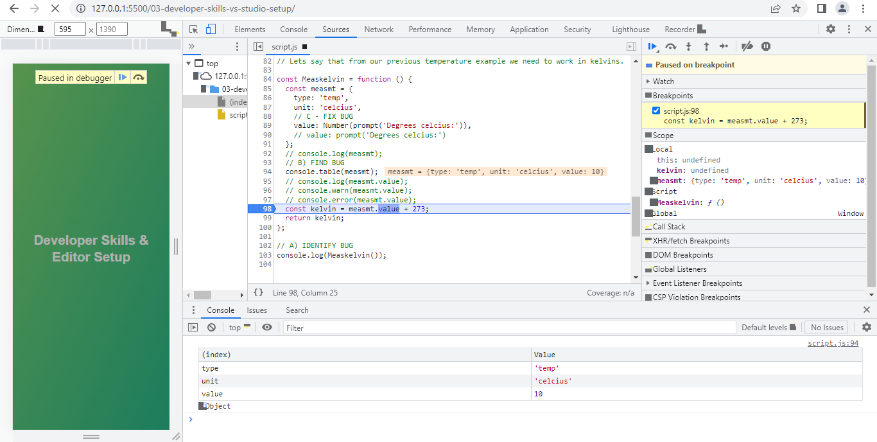
After pressing the resume button the code runs until it pauses on the previously set breakpoint. In the scope window the results of the last executed piece of code before the breakpoint will be shown for analysis. The script window shows the last executed line in the code before the breakpoint and the breakpoint is highlighted.
When finished with the debugger, don’t forget to remove the breakpoint by clicking on the blue tab in the left margin.

Slide 79
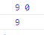
DEBUGGING 2: Here we have changed the previous code to start the min and max at zero rather than the first values of the arrays. The temperature array values are modified also.
const tempArr1 = [3, 5, 1]; // const tempArr1 = [3, -2, -6, -1, 'error', 9, 13, 17];
const tempArr2 = [9, 4, 5]; // const tempArr2 = [-3, 5, 1, 5, 18, 16, 30, 35];
const calcTempAmplBug = function (tempArr1, tempArr2) {
const tempArr = tempArr1.concat(tempArr2);
let max = 0; // let max = tempArr[0];
let min = 0; // let min = tempArr[0];
for (let i = 0; i < tempArr.length; i++) {
const curTemp = tempArr[i];
if (typeof curTemp !== 'number') continue;
if (curTemp > max) max = curTemp;
if (curTemp < min) min = curTemp;
}
console.log(max, min);
return max - min;
};
const amplBug = calcTempAmplBug(tempArr1, tempArr2);
console.log(amplBug);
This code now produces a bug with the output of max temp being 9 and min temp being 0. However looking in the arrays of values we see that the lowest temp is 1.

Slide 80
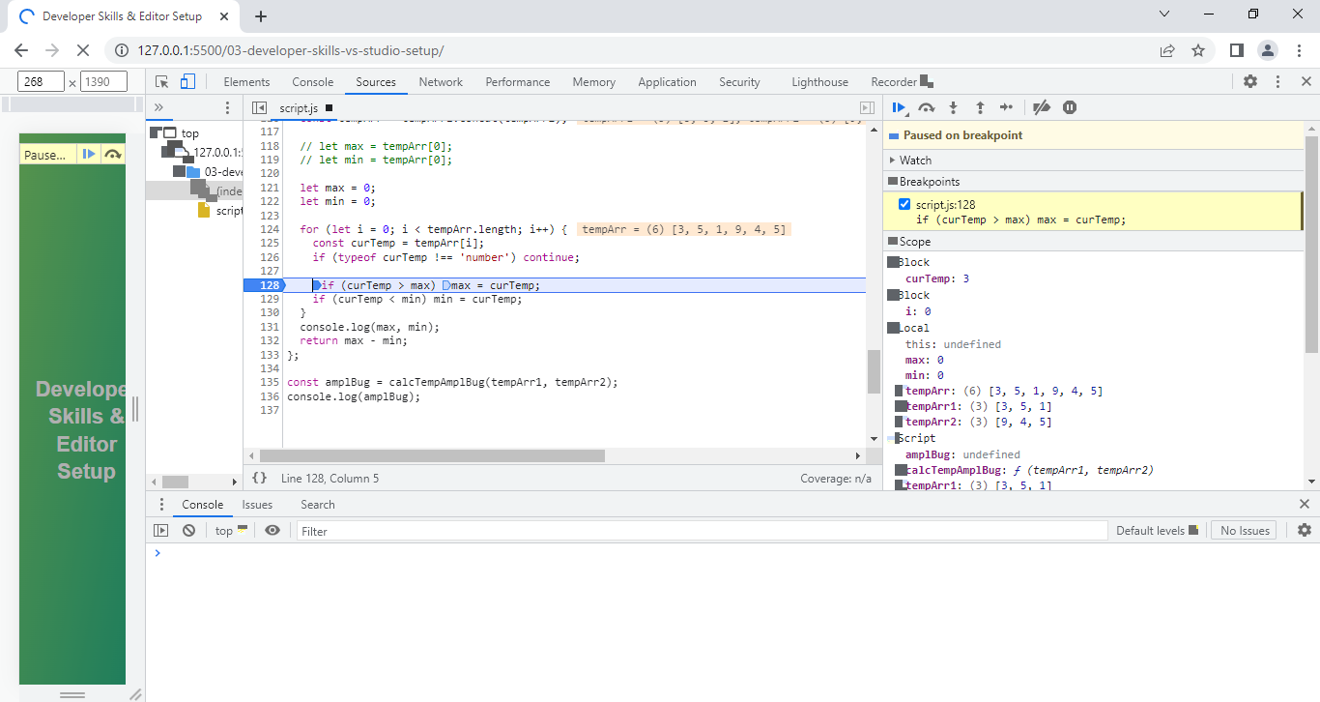
Debugger is especially useful for diagnosing problems in loops. Here I have a breakpoint set at the if statement for max temp and I can see that it has run up to this breakpoint and paused producing a curTemp of three which is the first value in the array.
When I hit the resume button the code reverts back to the beginning again running up to the breakpoint again and pausing. This time it gives curTemp of 5 which is the second value in the array. This time the max value is set to 5 because this is the highest value so far in the arrays.

Slide 81
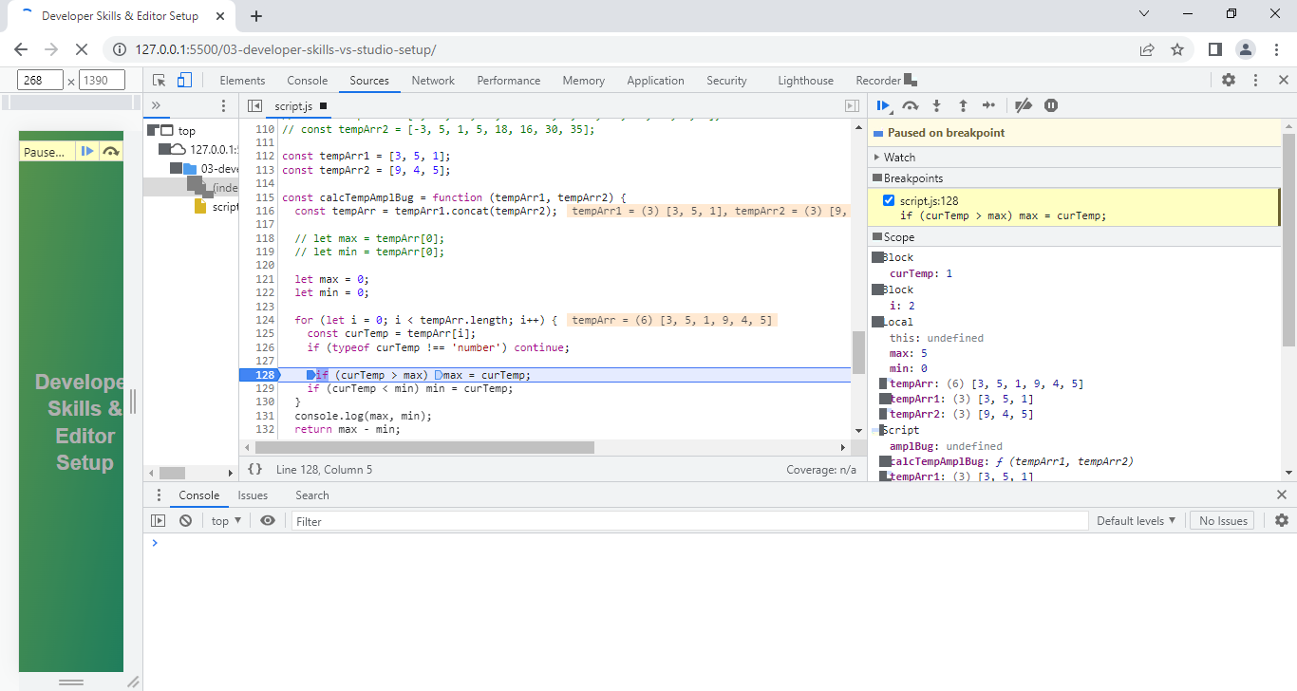
If I resume the code again it starts from the beginning and runs through the loop getting a curTemp of 1. But note how the min value stays at zero. Note also The screen outputs showing the calculated values in the arrays.

Slide 82

Two more runs through the loop and it now sets the max to 9 but the min is still set to zero despite 1 being the lowest value in the array.
Two more runs through the loop and it now sets the max to 9 but the min is still set to zero despite 1 being the lowest value in the array.

Slide 83
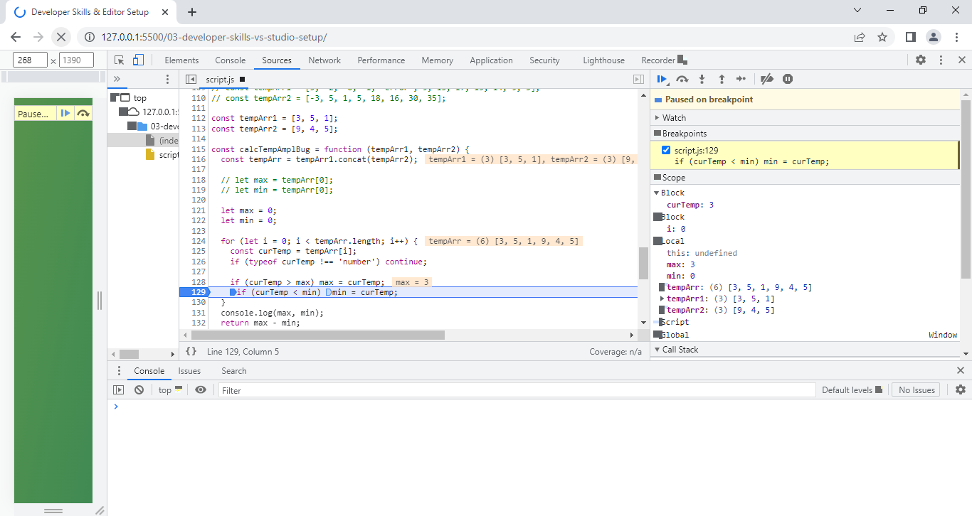
Now the breakpoint can be moved to the if statement for min. First run through the loop and it returns a curTemp of 3 and sets the max value.
I can keep resuming the loop and running through it multiple times observing that the min temp stays at zero rather than being set to 1 which is the lowest value in the array so I therefore know that I need to change the min = 0 line of code.

Slide 84
We can actually call the debugger direct from our code by inserting the line debugger; above the breakpoint that we want.
const tempArr1 = [3, 5, 1]; // const tempArr1 = [3, -2, -6, -1, 'error', 9, 13, 17];
const tempArr2 = [9, 4, 5]; // const tempArr2 = [-3, 5, 1, 5, 18, 16, 30, 35];
const calcTempAmplBug = function (tempArr1, tempArr2) {
const tempArr = tempArr1.concat(tempArr2);
let max = 0; // let max = tempArr[0];
let min = 0; // let min = tempArr[0];
for (let i = 0; i < tempArr.length; i++) {
const curTemp = tempArr[i];
if (typeof curTemp !== 'number') continue;
debugger;
if (curTemp > max) max = curTemp;
if (curTemp < min) min = curTemp;
}
console.log(max, min);
return max - min;
};
const amplBug = calcTempAmplBug(tempArr1, tempArr2);
console.log(amplBug);

Slide 85
Coding Challenge:
Given an array of forecasted maximum temperatures, the thermometer displays a string with these temperatures.
Example: [17,21,23] will print "...17ºC in 1 days ...21ºC in 2 days ...23ºC in 3 days“
Create a function 'printForecast' which takes in an array 'arr' and logs a string like the above to the console.
Use the problem solving framework, understand the problem and break it up into sub problems.
Test data 1: [17,21,23]
Test data 2: [12, -5, 0, 4]

Slide 86
const arr1 = [17, 21, 23];
const arr2 = [12, -5, 0, 4];
// METHOD 1
const printForecast = function (arr) {
let str = '';
for (let i = 0; i < arr.length; i++) {
const dayTemp = ` ...${arr[i]}ºC in ${i + 1} days`;
str += dayTemp;
}
console.log(str);
};
printForecast(arr1);
// METHOD 2
const printForecast2 = function (arr) {
let str = '';
for (let i = 0; i < arr.length; i++) {
str += `${arr[i]}ºC in ${i + 1} days ...`;
}
console.log('...' + str);
};
printForecast2(arr2);

Slide 87
JavaScript in the browser: DOM and Events Fundamentals – Guess My Number

Slide 88
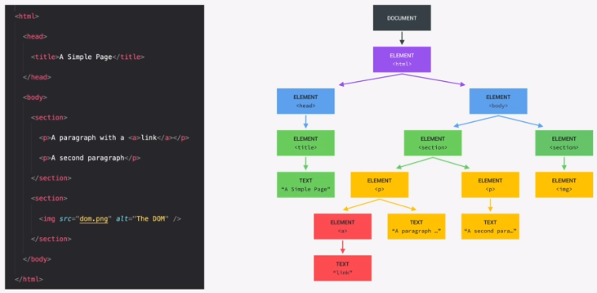
What is the DOM?
We are going to make JavaScript Interact with the elements on the page using DOM manipulation.
DOM stands for Document Object Model and it is basically a structured representation of the html document. The DOM can be considered a connection point between HTML and JavaScript.
The DOM is represented in tree structure and is automatically created by the browser.

Slide 89


We can interact with each of the HTML elements in JavaScript.
There is a special element in the DOM called the document which is the root and the entry point into the tree structure and we need it to start selecting elements.
HTML usually has two child elements, Head and Body so they are siblings to the document.
As we move deeper into the tree we see that the relationship is child to parent so for example the head html tag has child element of title. Elements also have sibling relationships.
Whatever is in the html document also has to be in the DOM. The DOM is a complete representation of the HTML document.
DOM methods & Properties NOT part of JavaScript
JAVASCRIPT
DOM methods & properties for DOM manipulation. For example document.querySelector
X
JavaScript is simply a dialect of ECMAScript
The DOM methods and properties are part of web APIs which the browser implements and that we can access from our JavaScript code. APIs are libraries that are written and available for us to use in the browser.

Slide 90
'use strict';
We can inspect a html element's text content using document.querySelector and .textContent.
Note that we identify the element by it’s class like in CSS, in this case .message.
console.log(document.querySelector('.message').textContent);
Using querySelector and .textContent we can manipulate the textContent of the class message.
document.querySelector('.message').textContent = 'Correct Number! 🎈';
console.log(document.querySelector('.message').textContent);
We can also manipulate other elements of the DOM by querySelect the class and setting the textContent.
document.querySelector('.number').textContent = '13';
console.log(document.querySelector('.number').textContent);
document.querySelector('.score').textContent = '10';
console.log(document.querySelector('.score').textContent);
Class ‘guess’ is an input so what we want to querySelect is the .value of that input property. We can also manipulate value.
document.querySelector('.guess').value = 23;
console.log(document.querySelector('.guess').value);
<section class="left">
<input type="number" class="guess" />
<button class="btn check">Check!</button>
</section>

Slide 91
Now we can make our application actually do something when we click on the page. For that we can use an event listener so that JavaScript reacts to the event.
In the below code snippet we querySelect the element by its class name then add an event listener to it.
The event listener is an inbuilt function that takes two parameters, We have to specify what type of event, in this case a click. The we specify a function that we want it to execute, in this case a simple console log of the value of another element, the guess element.
Note that the function within the event Listener will only be executed if the ‘.check’ element is clicked.
We can also do some DOM manipulation within the function within the event listener, In this case we change the text Content of another element called ‘.message’.
document.querySelector('.check').addEventListener('click', function () {
console.log(document.querySelector('.guess').value);
});
document.querySelector('.check').addEventListener('click', function () {
console.log(document.querySelector('.guess').value);
document.querySelector('.message').textContent = 'Correct Number! 🎈';
});

Slide 92
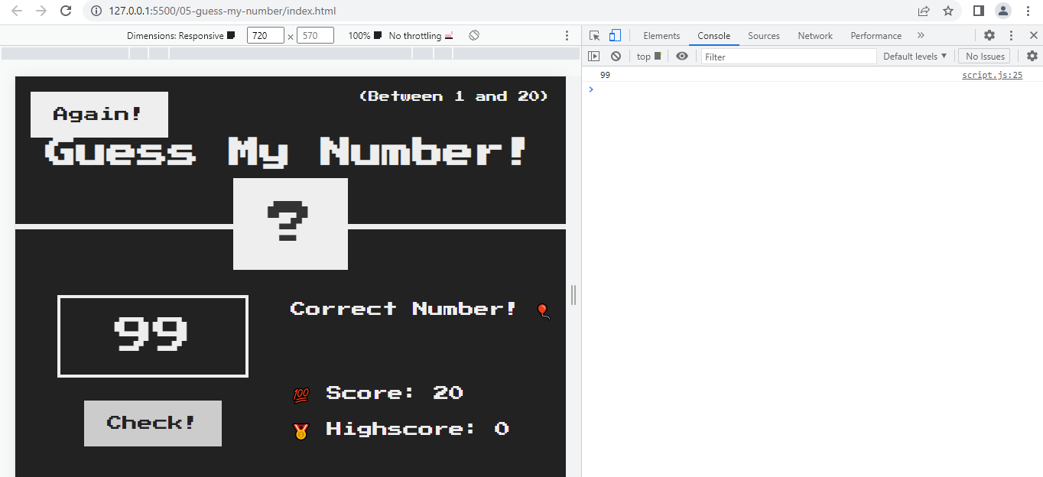
The event listener is attached to the element with class ‘.check’
Once the event listener is triggered with a click, the function within the event listener console logs the value of the input with class ‘.guess’. The DOM manipulation of class ‘.message’ also occurs.

Slide 93
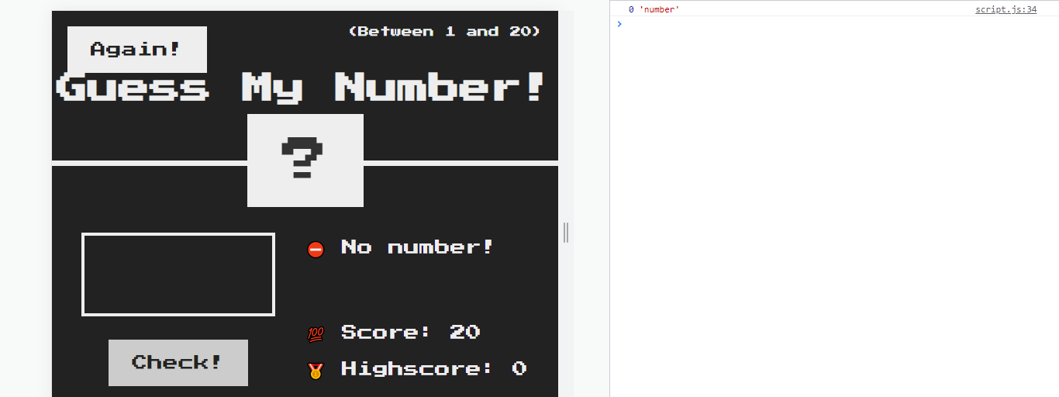
Now lets store the input value as a variable called guess. Note that most inputs, by default have a data type of string so we will need to convert the variable to a number for it to be useful later.
document.querySelector('.check').addEventListener('click', function () {
const guess = Number(document.querySelector('.guess').value);
console.log(guess, typeof guess);
But what if a user has not entered a number before triggering the event listener?. Here we check for a null of the variable guess and DOM manipulate the ‘.message’ element to say No number!
if (!guess) {
document.querySelector('.message').textContent = '⛔ No number!';
}
});

Slide 94
IMPLEMENT GAME LOGIC:
Define the secret random number:
Math.Random() will produce a random number between zero and 1.
To get a decimal number between 0 and 20 we can multiply by 20.
Now we can remove the decimal part by truncating the number using Math.trunc().
But this will give a number between zero and 19 when what we want is a number between 1 and 20 so we can just add 1 to it.
const secretNumber = Math.trunc(Math.random() * 20) + 1;
document.querySelector('.number').textContent = secretNumber;
document.querySelector('.check').addEventListener('click', function () {
const guess = Number(document.querySelector('.guess').value);
if (!guess) {
document.querySelector('.message').textContent = '⛔ No number!';
} else if (guess === secretNumber) {
document.querySelector('.message').textContent = '🏆 Correct number!';
}
});
If the user guesses the secret number we want a success message of ‘correct number’

Slide 95
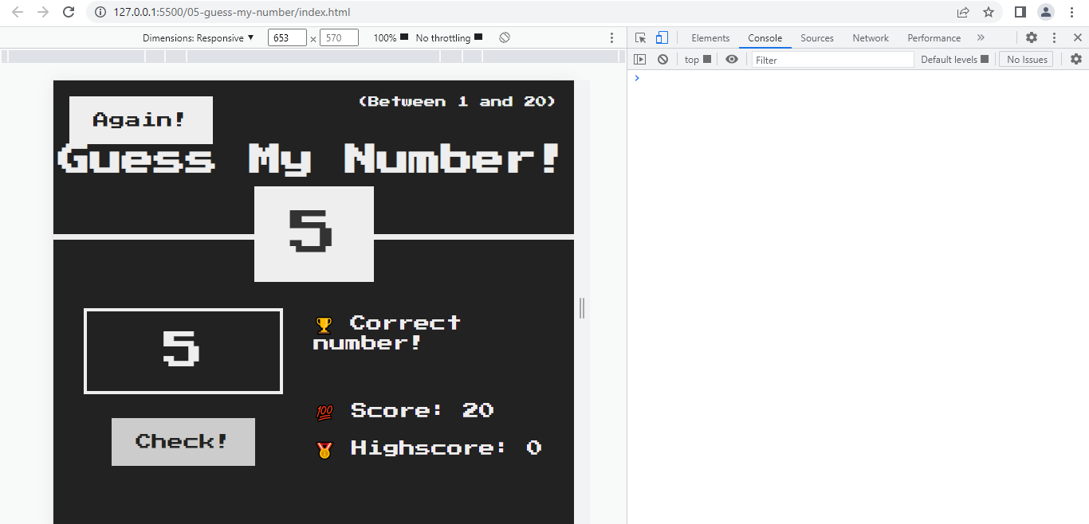
Here we are DOM manipulating the element with class ‘number’ to change the text content to variable secret number for testing purposes.
When we input 5 and trigger the event listener function with a click, The if statement first checks that variable guess is not empty/null. With the if Else we check if the guess is equal to the sectret number and dom manipulate the element ‘.message’ to say correct number if true.

Slide 96
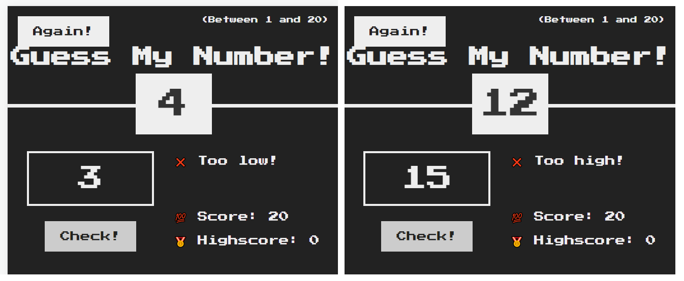
Now lets handle the scenarios for when the guess is bigger or smaller than the secret number.
const secretNumber = Math.trunc(Math.random() * 20) + 1;
document.querySelector('.number').textContent = secretNumber;
document.querySelector('.check').addEventListener('click', function () {
const guess = Number(document.querySelector('.guess').value);
if (!guess) {
document.querySelector('.message').textContent = '⛔ No number!';
} else if (guess === secretNumber) {
document.querySelector('.message').textContent = '🏆 Correct number!';
} else if (guess > secretNumber) {
document.querySelector('.message').textContent = '❌ Too high!';
} else if (guess < secretNumber) {
document.querySelector('.message').textContent = '❌ Too low!';
}
});

Slide 97
Now lets implement the score where the score starts at 20 and decreases by 1 each time an incorrect guess is made. We want to recalculate the score and update the element score with the new value for an incorrect guess.
const secretNumber = Math.trunc(Math.random() * 20) + 1;
let score = 20;
document.querySelector('.number').textContent = secretNumber;
document.querySelector('.check').addEventListener('click', function () {
const guess = Number(document.querySelector('.guess').value);
if (!guess) {
document.querySelector('.message').textContent = '⛔ No number!';
} else if (guess === secretNumber) {
document.querySelector('.message').textContent = '🏆 Correct number!';
} else if (guess > secretNumber) {
document.querySelector('.message').textContent = '❌ Too high!';
score--;
document.querySelector('.score').textContent = score;
} else if (guess < secretNumber) {
document.querySelector('.message').textContent = '❌ Too low!';
score--;
document.querySelector('.score').textContent = score;
}
});

Slide 98
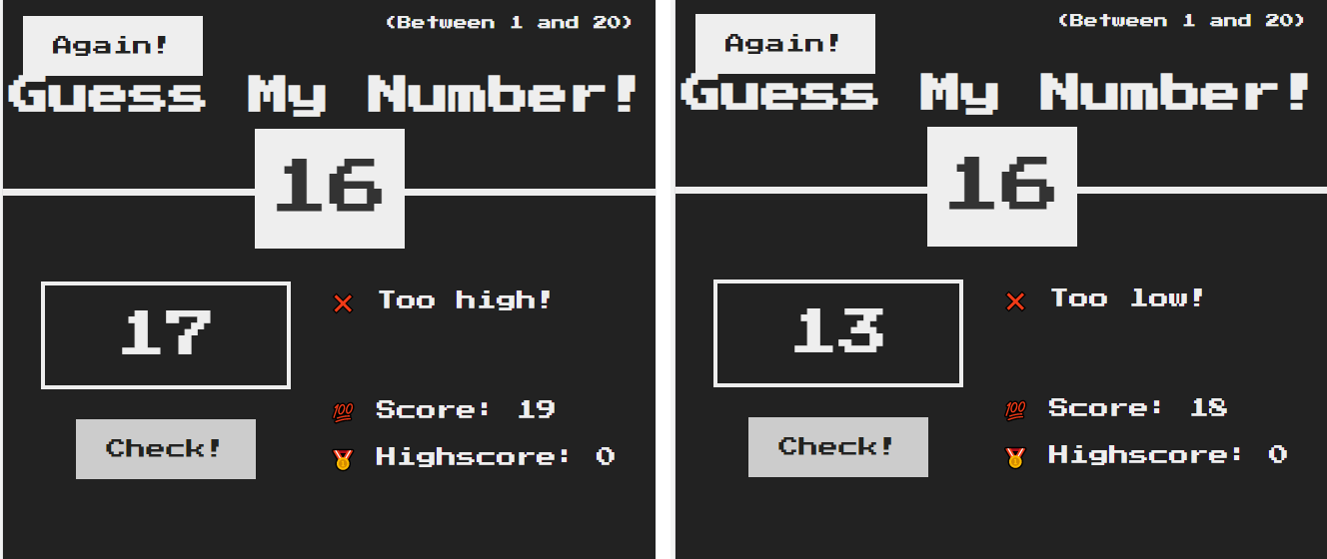
Each time an incorrect guess is made, the score is decreased by 1.
However, if we keep clicking the score will decrease by 1. lets say that we guess incorrectly more than 20 times then the score will be a negative number. What we need is some logic that says if score is above zero then allow guessing. Else DOM manipulate ‘.message’ to you loose and set the score to zero.

Slide 99
const secretNumber = Math.trunc(Math.random() * 20) + 1;
let score = 20;
document.querySelector('.check').addEventListener('click', function () {
const guess = Number(document.querySelector('.guess').value);
if (!guess) {
document.querySelector('.message').textContent = '⛔ No number!';
} else if (guess === secretNumber) {
document.querySelector('.message').textContent = '🏆 Correct number!';
} else if (guess > secretNumber) {
if (score > 1) {
document.querySelector('.message').textContent = '❌ Too high!';
score--;
document.querySelector('.score').textContent = score;
} else {
document.querySelector('.message').textContent = '🔥You lost the Game!';
document.querySelector('.score').textContent = 0;
}
} else if (guess < secretNumber) {
if (score > 1) {
document.querySelector('.message').textContent = '❌ Too low!';
score--;
document.querySelector('.score').textContent = score;
} else {
document.querySelector('.message').textContent = '🔥You lost the Game!';
document.querySelector('.score').textContent = 0;
}
}
});

Slide 100
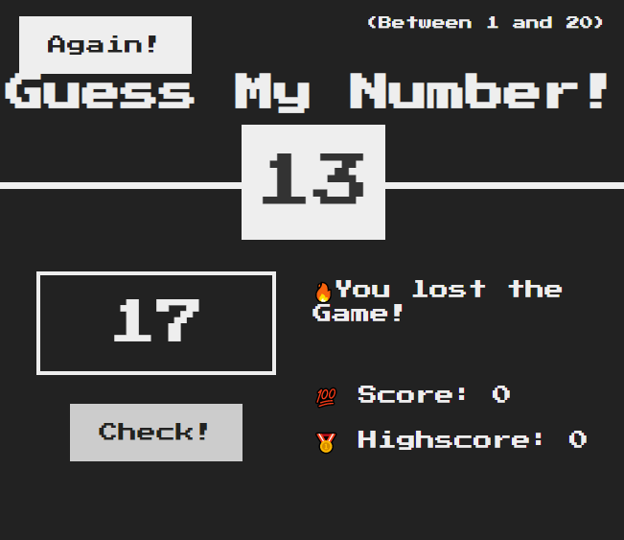
Now the game only lets us guess if the score is above zero, otherwise it will change the ‘.message’ to you loose and set the score to zero.

Slide 101
Manipulating CSS styles using JavaScript.
When the player wins the game we want the background colour of the whole screen to change to green. We also want to make the element .number wider when the player wins and display the secret number.
const secretNumber = Math.trunc(Math.random() * 20) + 1;
let score = 20;
document.querySelector('.check').addEventListener('click', function () {
const guess = Number(document.querySelector('.guess').value);
// When there is no input
if (!guess) {
document.querySelector('.message').textContent = '⛔ No number!';
// When player wins
} else if (guess === secretNumber) {
document.querySelector('.message').textContent = '🏆 Correct number!’;
document.querySelector('.number').textContent = secretNumber;
document.querySelector('body').style.backgroundColor = '#60b347';
document.querySelector('.number').style.width = '30rem’;
Note 1: when css style property has a two word name like background-color in javascript it becomes backgroundColor. We remove the hyphen and use camel case.
Note 2: The style property value must always be a string, i.e. within quotes.

Slide 102
// When guess is too high
} else if (guess > secretNumber) {
if (score > 1) {
document.querySelector('.message').textContent = '❌ Too high!';
score--;
document.querySelector('.score').textContent = score;
} else {
document.querySelector('.message').textContent = '🔥You lost the Game!';
document.querySelector('.score').textContent = 0;
}
// WHen guess is too low
} else if (guess < secretNumber) {
if (score > 1) {
document.querySelector('.message').textContent = '❌ Too low!';
score--;
document.querySelector('.score').textContent = score;
} else {
document.querySelector('.message').textContent = '🔥You lost the Game!';
document.querySelector('.score').textContent = 0;
}
}
});

Slide 103
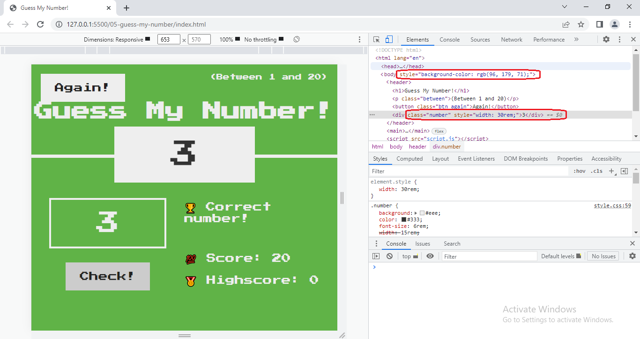
Note that when we change CSS style in JavaScript, It does not modify the CSS file but applies the changes as inline style to the html element in the DOM.

Slide 104
CODING CHALLENGE 1: Implement a game reset function, so the player can make a new guess.
1. Select the element with the 'again' class and attach a click event handler.
2. In the handler function, restore initial values of the score and SecretNumber variables.
3. Restore the initial conditions of the message, number, score and guess input field.
4. Also restore the original background colour (#222) and number width (15rem);
let secretNumber = Math.trunc(Math.random() * 20) + 1;
let score = 20;
document.querySelector('.check').addEventListener('click', function () {
const guess = Number(document.querySelector('.guess').value);
// When there is no input
if (!guess) {
document.querySelector('.message').textContent = '⛔ No number!';
// When player wins
} else if (guess === secretNumber) {
document.querySelector('.message').textContent = '🏆 Correct number!';
document.querySelector('.number').textContent = secretNumber;
document.querySelector('body').style.backgroundColor = '#60b347';
document.querySelector('.number').style.width = '30rem';

Slide 105
// When guess is too high
} else if (guess > secretNumber) {
if (score > 1) {
document.querySelector('.message').textContent = '❌ Too high!';
score--;
document.querySelector('.score').textContent = score;
} else {
document.querySelector('.message').textContent = '🔥You lost the Game!';
document.querySelector('.score').textContent = 0;
}
// When guess is too low
} else if (guess < secretNumber) {
if (score > 1) {
document.querySelector('.message').textContent = '❌ Too low!';
score--;
document.querySelector('.score').textContent = score;
} else {
document.querySelector('.message').textContent = '🔥You lost the Game!';
document.querySelector('.score').textContent = 0;
}
}
});
document.querySelector('.again').addEventListener('click', function () {
secretNumber = Math.trunc(Math.random() * 20) + 1;
let score = 20;
document.querySelector('.message').textContent = 'Start guessing...';
document.querySelector('.score').textContent = score;
document.querySelector('.number').textContent = '?';
document.querySelector('.guess').value = '';
document.querySelector('body').style.backgroundColor = '#222';
document.querySelector('.number').style.width = '15rem';
});

Slide 106
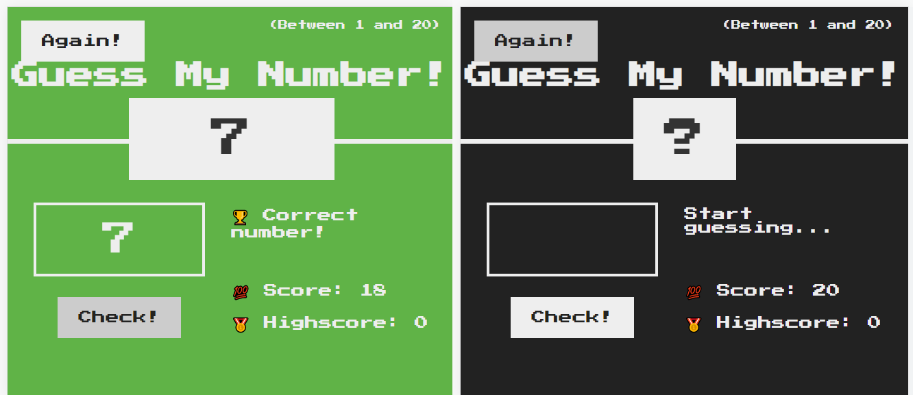
document.querySelector('.again').addEventListener('click', function () {
secretNumber = Math.trunc(Math.random() * 20) + 1;
score = 20;
document.querySelector('.message').textContent = 'Start guessing...';
document.querySelector('.score').textContent = score;
document.querySelector('.number').textContent = '?';
document.querySelector('.guess').value = '';
document.querySelector('body').style.backgroundColor = '#222';
document.querySelector('.number').style.width = '15rem';
});

Slide 107
IMPLEMENT HIGH SCORE FUNCTION: The highscore value is the highest score achieved over multiple games. i.e. first game score 10, second game score 15, third game score 17. the highscore would be 17.
let secretNumber = Math.trunc(Math.random() * 20) + 1;
let score = 20;
let highscore = 0;
document.querySelector('.check').addEventListener('click', function () {
const guess = Number(document.querySelector('.guess').value);
// When there is no input
if (!guess) {
document.querySelector('.message').textContent = '⛔ No number!';
// When player wins
} else if (guess === secretNumber) {
document.querySelector('.message').textContent = '🏆 Correct number!';
document.querySelector('.number').textContent = secretNumber;
document.querySelector('body').style.backgroundColor = '#60b347';
document.querySelector('.number').style.width = '30rem';
if (score > highscore) {
highscore = score;
document.querySelector('.highscore').textContent = highscore;
}

Slide 108
// When guess is too high
} else if (guess > secretNumber) {
if (score > 1) {
document.querySelector('.message').textContent = '❌ Too high!';
score--;
document.querySelector('.score').textContent = score;
} else {
document.querySelector('.message').textContent = '🔥You lost the Game!';
document.querySelector('.score').textContent = 0;
}
// When guess is too low
} else if (guess < secretNumber) {
if (score > 1) {
document.querySelector('.message').textContent = '❌ Too low!';
score--;
document.querySelector('.score').textContent = score;
} else {
document.querySelector('.message').textContent = '🔥You lost the Game!';
document.querySelector('.score').textContent = 0;
}
}
});

Slide 109
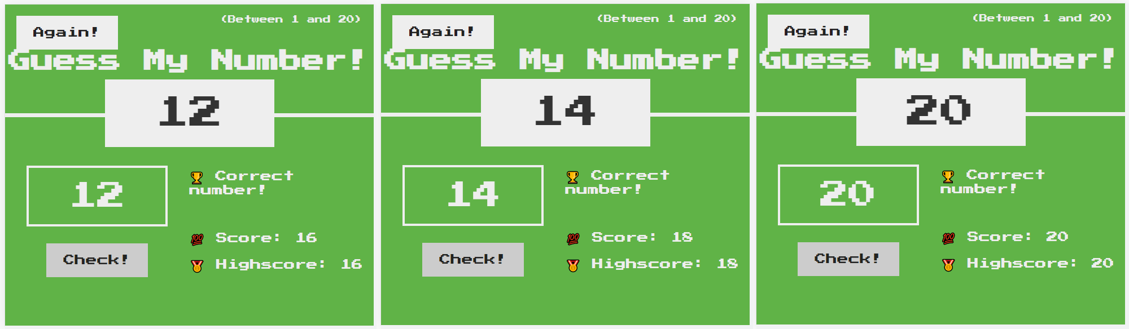
document.querySelector('.again').addEventListener('click', function () {
secretNumber = Math.trunc(Math.random() * 20) + 1;
score = 20;
document.querySelector('.message').textContent = 'Start guessing...';
document.querySelector('.score').textContent = score;
document.querySelector('.number').textContent = '?';
document.querySelector('.guess').value = '';
document.querySelector('body').style.backgroundColor = '#222';
document.querySelector('.number').style.width = '15rem';
});
Now the highscore changes if in subsequent rounds the player scores more than before.

Slide 110
Refactoring out code: The dry principle
Looking over the code we have sections that are almost duplicate code. We can tidy this up by reducing duplicate code. The advantage of this is that if we change something like an element class then we would have to change it in multiple places in the code and it can become a nightmare of bugs. We do refactoring to eliminate duplicate code and clean it up.
// When guess is too high
} else if (guess > secretNumber) {
if (score > 1) {
document.querySelector('.message').textContent = '❌ Too high!';
score--;
document.querySelector('.score').textContent = score;
} else {
document.querySelector('.message').textContent = '🔥You lost the Game!';
document.querySelector('.score').textContent = 0;
}
// When guess is too low
} else if (guess < secretNumber) {
if (score > 1) {
document.querySelector('.message').textContent = '❌ Too low!';
score--;
document.querySelector('.score').textContent = score;
} else {
document.querySelector('.message').textContent = '🔥You lost the Game!';
document.querySelector('.score').textContent = 0;
}
}
});
Step 1 is to identify duplicate or almost identical code.
If the guess is too high or the guess is too low are basically the same code. What we can really refactor this to is if the guess is not equal to secretNumber.

Slide 111
This part of the code stays the same
let secretNumber = Math.trunc(Math.random() * 20) + 1;
let score = 20;
let highscore = 0;
document.querySelector('.check').addEventListener('click', function () {
const guess = Number(document.querySelector('.guess').value);
// When there is no input
if (!guess) {
document.querySelector('.message').textContent = '⛔ No number!';
// When player wins
} else if (guess === secretNumber) {
document.querySelector('.message').textContent = '🏆 Correct number!';
document.querySelector('.number').textContent = secretNumber;
document.querySelector('body').style.backgroundColor = '#60b347';
document.querySelector('.number').style.width = '30rem';
if (score > highscore) {
highscore = score;
document.querySelector('.highscore').textContent = highscore;
}

Slide 112
// When guess is not equal to secretNumber
} else if (guess !== secretNumber) {
if (score > 1) {
document.querySelector('.message').textContent =
guess > secretNumber ? '❌ Too high!' : '❌ Too low!';
score--;
document.querySelector('.score').textContent = score;
} else {
document.querySelector('.message').textContent = '🔥You lost the Game!';
document.querySelector('.score').textContent = 0;
}
}
});
document.querySelector('.again').addEventListener('click', function () {
secretNumber = Math.trunc(Math.random() * 20) + 1;
score = 20;
document.querySelector('.message').textContent = 'Start guessing...';
document.querySelector('.score').textContent = score;
document.querySelector('.number').textContent = '?';
document.querySelector('.guess').value = '';
document.querySelector('body').style.backgroundColor = '#222';
document.querySelector('.number').style.width = '15rem';
});
Here we can reduce the guess not equal to secretNumber to a ternary operator to change the message. The rest of the code is the same.

Slide 113
let secretNumber = Math.trunc(Math.random() * 20) + 1;
let score = 20;
let highscore = 0;
const displayMessage = function (message) {
document.querySelector('.message').textContent = message;
};
document.querySelector('.check').addEventListener('click', function () {
const guess = Number(document.querySelector('.guess').value);
// When there is no input
if (!guess) {
displayMessage('⛔ No number!');
// When player wins
} else if (guess === secretNumber) {
displayMessage('🏆 Correct number!');
document.querySelector('.number').textContent = secretNumber;
document.querySelector('body').style.backgroundColor = '#60b347';
document.querySelector('.number').style.width = '30rem’;
if (score > highscore) {
highscore = score;
document.querySelector('.highscore').textContent = highscore;
}
Step 2 is to identify duplicate or almost identical lines of code and consider putting it in a function and call that function multiple times when we need it.
Call the function
Call the function

Slide 114
if (score > highscore) {
highscore = score;
document.querySelector('.highscore').textContent = highscore;
}
// When guess is not equal to secretNumber
} else if (guess !== secretNumber) {
if (score > 1) {
displayMessage(guess > secretNumber ? '❌ Too high!' : '❌ Too low!');
score--;
document.querySelector('.score').textContent = score;
} else {
displayMessage('🔥You lost the Game!');
document.querySelector('.score').textContent = 0;
}
}
});
document.querySelector('.again').addEventListener('click', function () {
secretNumber = Math.trunc(Math.random() * 20) + 1;
score = 20;
displayMessage('Start guessing...');
document.querySelector('.score').textContent = score;
document.querySelector('.number').textContent = '?';
document.querySelector('.guess').value = '';
document.querySelector('body').style.backgroundColor = '#222';
document.querySelector('.number').style.width = '15rem';
});
Call the
function
Call the function
Call the function

Slide 115
JavaScript in the browser: DOM and Events Fundamentals – Pop up Modal Window

Slide 116

Project: Modal Window.
We first start by defining all the elements we want to manipulate as variables. Note how in the HTML we have three modal buttons so when selecting multiple elements by class we need to use querySelectorAll.
'use strict';
const modal = document.querySelector('.modal');
const overlay = document.querySelector(‘.overlay');
const btnCloseModal = document.querySelector(‘.close-modal');
const btnsOpenModel = document.querySelectorAll(‘.show-modal');
console.log(btnsOpenModel);
If we console log this we get a nodelist which is like an array.

Slide 117
'use strict';
const modal = document.querySelector('.modal');
const overlay = document.querySelector('.overlay');
const btnCloseModal = document.querySelector('.close-modal');
const btnsOpenModel = document.querySelectorAll('.show-modal');
console.log(btnsOpenModel);
for (let i = 0; i < btnsOpenModel.length; i++)
btnsOpenModel[i].addEventListener('click', function () {
console.log('button clicked');
modal.classList.remove('hidden');
overlay.classList.remove('hidden');
});
btnCloseModal.addEventListener('click', function () {
modal.classList.add('hidden');
overlay.classList.add('hidden');
});
overlay.addEventListener('click', function () {
modal.classList.add('hidden');
overlay.classList.add('hidden');
});
We create a for loop to decide what happens to each of the buttons.
And then add an event listener for clicks of the button. Within the event listener we want to remove the hidden class for two elements.
The modal can be closed by either clicking on the overlay outside of the modal or using the close button in the modal.

Slide 118
Refine the close modal function with a named function.
const modal = document.querySelector('.modal');
const overlay = document.querySelector('.overlay');
const btnCloseModal = document.querySelector('.close-modal');
const btnsOpenModel = document.querySelectorAll('.show-modal');
console.log(btnsOpenModel);
for (let i = 0; i < btnsOpenModel.length; i++)
btnsOpenModel[i].addEventListener('click', function () {
console.log('button clicked');
modal.classList.remove('hidden');
overlay.classList.remove('hidden');
});
const closeModal = function () {
modal.classList.add('hidden’); Named Function
overlay.classList.add('hidden');
};
btnCloseModal.addEventListener('click', closeModal); Call Named Function in
overlay.addEventListener('click', closeModal); Event Handler

Slide 119
Refine the open modal function with a named function.
const modal = document.querySelector('.modal');
const overlay = document.querySelector('.overlay');
const btnCloseModal = document.querySelector('.close-modal');
const btnsOpenModel = document.querySelectorAll('.show-modal');
const openModal = function () {
console.log('button clicked');
modal.classList.remove('hidden’); Named Function
overlay.classList.remove('hidden');
};
const closeModal = function () {
modal.classList.add('hidden');
overlay.classList.add('hidden');
};
for (let i = 0; i < btnsOpenModel.length; i++) Call Named Function in
btnsOpenModel[i].addEventListener('click', openModal); Event Handler
btnCloseModal.addEventListener('click', closeModal);
overlay.addEventListener('click', closeModal);

Slide 120
Key press events are global so they normally happen on the whole document and have three varieties: Keyup, Keydown, Keypress.
Keydown: is when we strike a key
keyup: is when we lift off a key
Keypress: Depreciated - event is fired when a key that produces a character value is pressed down
document.addEventListener('keydown', function (e) {
console.log('A key was pressed');
console.log(e);
});
The event listener for a key press event stores the key value in the function so we can call it e for event and console log it

Slide 121

Here we see a property of key which holds the value of “escape” because I pressed the escape key
We want to execute the close modal function if the modal is visible, i.e. does not contain the class of ‘hidden’ and if the e property of “key” is Escape.
document.addEventListener('keydown', function (e) {
if (e.key === 'Escape' && !modal.classList.contains('hidden')) {
closeModal();
}
});

Slide 122
JavaScript in the browser: DOM and Events Fundamentals – Pig Game

Slide 123

Project: Pig Game.

Slide 124
'use strict';
// Selecting elements
const score0El = document.querySelector('#score--0');
const score1El = document.querySelector('#score--1');
const diceEl = document.querySelector('.dice');
const btnNew = document.querySelector('.btn--new');
const btnRoll = document.querySelector('.btn--roll');
const btnHold = document.querySelector('.btn--hold');
// Setting intitial values for elements
score0El.textContent = 0;
score1El.textContent = 0;
diceEl.classList.add('hidden');
// Rolling dice functionality
btnRoll.addEventListener('click' function() {
// 1. Generate random dice roll number
// 2. Display dice
// 3. Check for rolled 1: if true, switch to other player
})
First we define the variables that we are going to use.
Then we define some initial values for the elements
And we can make a start on the roll dice functionality by first defining what we want it to do.

Slide 125
// Selecting elements
const score0El = document.querySelector('#score--0');
const score1El = document.querySelector('#score--1');
const current0El = document.querySelector('#current--0');
const current1El = document.querySelector('#current--1');
const diceEl = document.querySelector('.dice');
const btnNew = document.querySelector('.btn--new');
const btnRoll = document.querySelector('.btn--roll');
const btnHold = document.querySelector('.btn--hold');
const Player0 = document.querySelector('#name--0');
const Player1 = document.querySelector('#name--1');
// Starting conditions
score0El.textContent = 0;
score1El.textContent = 0;
diceEl.classList.add('hidden');
let currentScore = 0;

Slide 126
// Rolling dice functionality
btnRoll.addEventListener('click', function () {
// 1. Generate random dice roll number
const dice = Math.trunc(Math.random() * 6) + 1;
console.log(dice);
// 2. Display dice
diceEl.classList.remove('hidden');
diceEl.src = `dice-${dice}.png`;
// 3. Check for rolled 1:
if (dice !== 1) {
// Add dice to current score
currentScore += dice;
current0El.textContent = currentScore; // Change later
} else {
// Switch to other player
}
});
If the dice roll is not 1 then we need to add the dice rolled value to the current score and update the current score on screen.

Slide 127

Now when the player clicks the roll dice button a random dice value is selected which is continually added to current score and updating the current element. Note that the image of the dice changes depending on the value because the filename for the image is dice-(value).png.

Slide 128
Switching the Active player
// Selecting elements
const player0El = document.querySelector('.player--0');
const player1El = document.querySelector('.player--1');
const score0El = document.querySelector('#score--0');
const score1El = document.querySelector('#score--1');
const current0El = document.querySelector('#current--0');
const current1El = document.querySelector('#current--1');
const diceEl = document.querySelector('.dice');
const btnNew = document.querySelector('.btn--new');
const btnRoll = document.querySelector('.btn--roll');
const btnHold = document.querySelector('.btn--hold');
// Starting conditions
score0El.textContent = 0;
score1El.textContent = 0;
diceEl.classList.add('hidden');
const scores = [0, 0];
let currentScore = 0;
let activePlayer = 0;
We define the variables for the two players.
We define a new immutable variable for active player and set it to zero. ( the active player is either zero or one)

Slide 129
// Rolling dice functionality
btnRoll.addEventListener('click', function () {
// 1. Generate random dice roll number
const dice = Math.trunc(Math.random() * 6) + 1;
console.log(dice);
// 2. Display dice
diceEl.classList.remove('hidden');
diceEl.src = `dice-${dice}.png`;
// 3. Check for rolled 1:
if (dice !== 1) {
// Add dice to current score
currentScore += dice;
document.getElementById(`current--${activePlayer}`).textContent = currentScore;
} else {
// Switch to other player
document.getElementById(`current--${activePlayer}`).textContent = 0;
currentScore = 0;
activePlayer = activePlayer === 0 ? 1 : 0;
player0El.classList.toggle('player--active');
player1El.classList.toggle('player--active');
}
});
When the player switches the current score needs to be reset to zero.
We can also toggle the class list to change the background-color of to show the current player. Toggle just means if it has class ‘player—active’ remove it. If it does not have class ‘player—active’ add it.

Slide 130

Now when the dice lands on 1 the active player changes, the score currentScore resets to zero and the background-colour flips to the other player.

Slide 131
Holding the current Score part 1
// Selecting elements
const player0El = document.querySelector('.player--0');
const player1El = document.querySelector('.player--1');
const score0El = document.querySelector('#score--0');
const score1El = document.querySelector('#score--1');
const current0El = document.querySelector('#current--0');
const current1El = document.querySelector('#current--1');
const diceEl = document.querySelector('.dice');
const btnNew = document.querySelector('.btn--new');
const btnRoll = document.querySelector('.btn--roll');
const btnHold = document.querySelector('.btn--hold');
// Starting conditions
score0El.textContent = 0;
score1El.textContent = 0;
diceEl.classList.add('hidden');
const scores = [0, 0];
let currentScore = 0;
let activePlayer = 0;
2)
2) We have an array of scores that contains two items. Scores[0] holds the score for player 0 and score[1] holds the score for player 1. Note that the position in the array is also the player

Slide 132
// Switch player function
const switchPlayer = function () {
document.getElementById(`current--${activePlayer}`).textContent = 0;
currentScore = 0;
activePlayer = activePlayer === 0 ? 1 : 0;
console.log(`active--player = ${activePlayer}`);
player0El.classList.toggle('player--active');
player1El.classList.toggle('player--active');
};
// Rolling dice functionality
btnRoll.addEventListener('click', function () {
// 1. Generate random dice roll number
const dice = Math.trunc(Math.random() * 6) + 1;
console.log(dice);
// 2. Display dice
diceEl.classList.remove('hidden');
diceEl.src = `dice-${dice}.png`;
// 3. Check for rolled 1:
if (dice !== 1) {
// Add dice to current score
currentScore += dice;
document.getElementById(`current--${activePlayer}`).textContent = currentScore;
} else {

Slide 133
// Switch to other player
switchPlayer();
}
});
btnHold.addEventListener('click', function () {
// 1. Add current score to active players score
scores[activePlayer] += currentScore;
console.log(scores);
document.getElementById(`score--${activePlayer}`).textContent = scores[activePlayer];
// 2. Check if player's score is >= 100
// Finish the Game
// Switch to the other player
switchPlayer();
});
5)
1) We add an event listener to the hold button and define the actions that we want this function to do.
1)
3)
4)
3) As the active player is either 0 or 1 we can use this to identify the position in the scores array and add the current score to that position value.
5)
4) We also need to update the score element of the active player.
5) Now when the hols is clicked we also want to switch player. But this is code we have used before so we put that code in a function and call it.

Slide 134

Now when the hold button is clicked the current value of the active player is added to the scores array.

Slide 135
Holding the current Score part 2
// Selecting elements
const player0El = document.querySelector('.player--0');
const player1El = document.querySelector('.player--1');
const score0El = document.querySelector('#score--0');
const score1El = document.querySelector('#score--1');
const current0El = document.querySelector('#current--0');
const current1El = document.querySelector('#current--1');
const diceEl = document.querySelector('.dice');
const btnNew = document.querySelector('.btn--new');
const btnRoll = document.querySelector('.btn--roll');
const btnHold = document.querySelector('.btn--hold');
// Starting conditions
score0El.textContent = 0;
score1El.textContent = 0;
diceEl.classList.add('hidden');
const scores = [0, 0];
let currentScore = 0;
let activePlayer = 0;

Slide 136
// Switch player function
const switchPlayer = function () {
document.getElementById(`current--${activePlayer}`).textContent = 0;
currentScore = 0;
activePlayer = activePlayer === 0 ? 1 : 0;
console.log(`active--player = ${activePlayer}`);
player0El.classList.toggle('player--active');
player1El.classList.toggle('player--active');
};
// Rolling dice functionality
btnRoll.addEventListener('click', function () {
// 1. Generate random dice roll number
const dice = Math.trunc(Math.random() * 6) + 1;
console.log(dice);
// 2. Display dice
diceEl.classList.remove('hidden');
diceEl.src = `dice-${dice}.png`;
// 3. Check for rolled 1:
if (dice !== 1) {
// Add dice to current score
currentScore += dice;
document.getElementById(`current--${activePlayer}`).textContent =
currentScore;

Slide 137
} else {
// Switch to other player
switchPlayer();
}
});
btnHold.addEventListener('click', function () {
// 1. Add current score to active players score
scores[activePlayer] += currentScore;
console.log(scores);
document.getElementById(`score--${activePlayer}`).textContent =
scores[activePlayer];
// 2. Check if player's score is >= 100
if (scores[activePlayer] >= 100) {
// Finish the Game
document.querySelector(`.player--${activePlayer}`).classList.add('player--winner');
document.querySelector(`.player--${activePlayer}`).classList.remove('player--active');
} else {
// Switch to the other player
switchPlayer();
}
});
When the active player’s core is greater than or equal to 100 we want to finish the game by adding a player--winner class and removing the player--active class.

Slide 138

Player-winner class added and player—active class removed.

Slide 139

However, We can still continue to play the game until both players have player-winner class! This needs to be fixed!

Slide 140
Holding the current Score part 2
// Selecting elements
const player0El = document.querySelector('.player--0');
const player1El = document.querySelector('.player--1');
const score0El = document.querySelector('#score--0');
const score1El = document.querySelector('#score--1');
const current0El = document.querySelector('#current--0');
const current1El = document.querySelector('#current--1');
const diceEl = document.querySelector('.dice');
const btnNew = document.querySelector('.btn--new');
const btnRoll = document.querySelector('.btn--roll');
const btnHold = document.querySelector('.btn--hold');
// Starting conditions
score0El.textContent = 0;
score1El.textContent = 0;
diceEl.classList.add('hidden');
const scores = [0, 0];
let currentScore = 0;
let activePlayer = 0;
let playing = true;
1) We add a Boolean variable called playing to hold a value of true if the game is playing and false if the game has finished.
1)

Slide 141
// Switch player function
const switchPlayer = function () {
document.getElementById(`current--${activePlayer}`).textContent = 0;
currentScore = 0;
activePlayer = activePlayer === 0 ? 1 : 0;
console.log(`active--player = ${activePlayer}`);
player0El.classList.toggle('player--active');
player1El.classList.toggle('player--active');
};
// Rolling dice functionality
btnRoll.addEventListener('click', function () {
// Is game playing
if (playing) {
// 1. Generate random dice roll number
const dice = Math.trunc(Math.random() * 6) + 1;
console.log(dice);
// 2. Display dice
diceEl.classList.remove('hidden');
diceEl.src = `dice-${dice}.png`;
2)
2) We wrap all the code that we want to only run if the game is playing in a if (playing) clause. Note that because playing is a Boolean we do not need to say if (playing === true)

Slide 142
// 3. Check for rolled 1:
if (dice !== 1) {
// Add dice to current score
currentScore += dice;
document.getElementById(`current--${activePlayer}`).textContent =
currentScore;
} else {
// Switch to other player
switchPlayer();
}
} // End of If playing
});
btnHold.addEventListener('click', function () {
if (playing) {
// 1. Add current score to active players score
scores[activePlayer] += currentScore;
console.log(scores);
document.getElementById(`score--${activePlayer}`).textContent =
scores[activePlayer];
3) For the event listener that handles the hold button we also wrap it in an If (playing)
2)
3)

Slide 143
// 2. Check if player's score is >= 100
if (scores[activePlayer] >= 100) {
// Finish the Game
playing = false;
diceEl.classList.add('hidden');
btnRoll.classList.add('hidden');
btnHold.classList.add('hidden');
document
.querySelector(`.player--${activePlayer}`)
.classList.add('player--winner');
document
.querySelector(`.player--${activePlayer}`)
.classList.remove('player--active');
} else {
// Switch to the other player
switchPlayer();
}
} // End of if playing
});
4) If the current players scores are greater than or equal to 100 the we want to stop the game playing so we set playing to false.
4)
5)
5) We can also set the dice, button roll and button hold to hidden.
3)

Slide 144

Now the game can only have one winner. Once a players score reaches 100 then the dice, roll and hold buttons are hidden.

Slide 145
New Game Button
// Selecting elements
const player0El = document.querySelector('.player--0');
const player1El = document.querySelector('.player--1');
const score0El = document.querySelector('#score--0');
const score1El = document.querySelector('#score--1');
const current0El = document.querySelector('#current--0');
const current1El = document.querySelector('#current--1');
const diceEl = document.querySelector('.dice');
const btnNew = document.querySelector('.btn--new');
const btnRoll = document.querySelector('.btn--roll');
const btnHold = document.querySelector('.btn--hold');
// Scoping the variables
let scores, currentScore, activePlayer, playing;
2) Now that we have the starting game variables set to the correct values it makes no sense to declare the values for the variables do we can just define them in one line of code.

Slide 146
// Game initialise function
const init = function () {
// 1. reset scores array to zero.
scores = [0, 0];
// 2. reset current score to zero
currentScore = 0;
// 3. Set active player to o
activePlayer = 0;
// 4. reset playing to true
playing = true;
// 5. reset player scores to zer0
score0El.textContent = 0;
score1El.textContent = 0;
// 6. reset current player scores to zero
current0El.textContent = 0;
current1El.textContent = 0;
// 7. remove hidden class from btnRoll and BtnHold, hide dice
diceEl.classList.add('hidden');
btnRoll.classList.remove('hidden');
btnHold.classList.remove('hidden');
// 3. Remove player--winner class
player0El.classList.remove('player--winner');
player1El.classList.remove('player--winner');
// 4. Remove player--active class from player 1 and add it to player 0
player0El.classList.add('player--active');
player1El.classList.remove('player--active');
};
1) For the new game button to work we need to reset all the variables to values that they were at the start of the game. It makes sense to put this code in an initialise function.

Slide 147
3) We will run the initialise function after creating it so that values are set to the correct numbers straight away.
init();
// Switch player function
const switchPlayer = function () {
document.getElementById(`current--${activePlayer}`).textContent = 0;
currentScore = 0;
activePlayer = activePlayer === 0 ? 1 : 0;
console.log(`active--player = ${activePlayer}`);
player0El.classList.toggle('player--active');
player1El.classList.toggle('player--active');
};
// Rolling dice functionality
btnRoll.addEventListener('click', function () {
// Is game playing
if (playing) {
// 1. Generate random dice roll number
const dice = Math.trunc(Math.random() * 6) + 1;
console.log(dice);
// 2. Display dice
diceEl.classList.remove('hidden');
diceEl.src = `dice-${dice}.png`;

Slide 148
// 3. Check for rolled 1:
if (dice !== 1) {
// Add dice to current score
currentScore += dice;
document.getElementById(`current--${activePlayer}`).textContent =
currentScore;
} else {
// Switch to other player
switchPlayer();
}
} // End of If playing
});
btnHold.addEventListener('click', function () {
if (playing) {
// 1. Add current score to active players score
scores[activePlayer] += currentScore;
console.log(scores);
document.getElementById(`score--${activePlayer}`).textContent =
scores[activePlayer];

Slide 149
// 2. Check if player's score is >= 100
if (scores[activePlayer] >= 100) {
// Finish the Game
playing = false;
diceEl.classList.add('hidden');
btnRoll.classList.add('hidden');
btnHold.classList.add('hidden');
document
.querySelector(`.player--${activePlayer}`)
.classList.add('player--winner');
document
.querySelector(`.player--${activePlayer}`)
.classList.remove('player--active');
} else {
// Switch to the other player
switchPlayer();
}
} // End of if playing
});
btnNew.addEventListener('click', init);
4) Now the event listener for the new game button just calls the initialise function when it is clicked.

Slide 150
How JavaScript works behind the Scenes.

Slide 151




High-Level
JavaScript high level overview
Garbage Collected
Interpreted or Just-in-time Compiled
Multi-Paradigm
Memory ← Computer Resources → CPU
Prototype-based Object-Orientated
C+ language
Javascript
Python
First Class Functions
Dynamic
Low-Level
High-Level
Single Threaded
Developer has to manage resources manually
Developer DOES NOT have to worry, Everything happens automatically
Non-Blocking Event Loop

Slide 152

High-Level
Garbage Collected
JavaScript has automatic Garbage-Collection which cleans the memory from time to time so we do not have to do it manually in the code.
Interpreted or Just-in-time Compiled
Multi-Paradigm
Prototype-based Object-Orientated
First Class Functions
Dynamic
Memory ← Computer Resources → CPU
Single Threaded
Non-Blocking Event Loop

Slide 153

High-Level
Garbage Collected
Interpreted or Just-in-time Compiled
Multi-Paradigm
Prototype-based Object-Orientated
First Class Functions
Dynamic
JavaScript is an interpreted or just-in-time complied code. I.e. It converts human readable JavaScript code in to machine readable code i.e. 1s and 0s.
Single Threaded
Non-Blocking Event Loop

Slide 154
High-Level
Paradigm: An approach and mindset of structuring code, which will direct your coding style and technique
Garbage Collected
Interpreted or Just-in-time Compiled
This is what we have been using so far in this course
Multi-Paradigm
1
Procedural Programming
Prototype-based Object-Orientated
2
Object-Orientated Programming (OOP)
3
Functional-Programming (FP):
First Class Functions
Dynamic
JavaScript is very versatile and flexible and can support any of the three paradigm´s
Single Threaded
Non-Blocking Event Loop

Slide 155

High-Level
Almost everything in JavaScript is an object (except for primitive values like strings or numbers etc)
Garbage Collected
Arrays are just objects.
We can use push method on arrays because of prototype inheritance.
We create arrays from array blueprint which is called a prototype.
The prototype contains all the methods we can use on it so we can reuse methods for all prototypes such as arrays.
Interpreted or Just-in-time Compiled
Multi-Paradigm
Prototype-based Object-Orientated
First Class Functions
Prototype
Dynamic
Our array inherits methods from Prototype
Single Threaded
Built from Prototype
Non-Blocking Event Loop

Slide 156

High-Level
In a language with First-Class Functions, Functions are simply treated as variables. We can pass them into other functions and return them from functions.
Garbage Collected
Interpreted or Just-in-time Compiled
We have already used a first class function when we passed the close modal function into the event listener function.
Not all languages have this ability.
Multi-Paradigm
Prototype-based Object-Orientated
Passing a function into a function as an argument – First-Class Functions!
First Class Functions
Dynamic
Single Threaded
Non-Blocking Event Loop

Slide 157



High-Level
Dynamically-typed Language:
Garbage Collected
No Data type definitions: Types become known at runtime.
Interpreted or Just-in-time Compiled
Data type of variable is automatically changed.
Multi-Paradigm
Prototype-based Object-Orientated
First Class Functions
Many other programming languages insist on manually assigned datatypes.
Dynamic
Single Threaded
Non-Blocking Event Loop

Slide 158
High-Level
Concurrency model: How the JavaScript Engine handles multiple tasks happening at the same time.
Garbage Collected
JavaScript runs in a single Thread so it can only do one thing at a time. ( A Thread is like a set of instructions that run in a computer’s CPU.)
Interpreted or Just-in-time Compiled
A long running task would therefore block the thread but we want non-blocking behaviour.
Multi-Paradigm
By using an Event loop. This takes long running tasks and executes them in the background then puts them back in the main thread once they are finished.
Prototype-based Object-Orientated
First Class Functions
Dynamic
Single Threaded
Non-Blocking Event Loop

Slide 159






JavaScript Engine and Runtime
A JavaScript engine is a program that executes JavaScript code. Below are examples of Engines.
Google V8 - Chrome and NodeJS
Nitro - Apple
Spider Monkey - Firefox.
Chakra Core - Microsoft Edge.
Any JavaScript Engine will include a call stack and a heap.
Execution Context
Objects in Memory
Where our code is executed.
Where our Objects are stored.
Call Stack Heap

Slide 160
Compilation vs Interpretation
Compilation: Entire code is converted into machine code at once, and written to a binary file that can be executed by a computer.
Source Code
Step 1:
Compilation
Portable File: Machine Code
Step 2:
Execution
Running Program
Interpretation: Interpreter runs through the source code and executes it line by line.
Source Code
Step 1:
Execution line by line
Running Program
JavaScript used to be a compilation language but the problem is that they are much more slower so it is now a mix between interpretation and compilation which is called just in time. The execution happens just after the compilation.

Slide 161

Modern Just-In-Time Compilation of Javascript
JavaScript Engine
Parsing means reading the code and splitting it up into known pieces such as variables to make an Abstract Syntax tree.
Parsing
AST
Compilation means taking the Abstract Syntax Tree and converting it to machine code.
Just-in-time compilation
Compilation
In the beginning the Engine creates a very basic un-optimised version of the code to the get the program running then in a background thread it optimises the code for better efficiency and updates the compilation.
AST
Optimisation
Happens in Call Stack
Execution
It then gets executes right away because modern JavaScript is Just-in-time.

Slide 162
JavaScript Runtime in the Browser
Functionalities provided to the engine accessible on windows object
Web APIs
Engine
DOM
TIMERS
Fetch API
…..
The call-back function is passed to the stack so that it can be executed.
CALLBACK QUEUE
Click
……
Data
timer
Click
Call Stack Heap
Example: Call-back function from DOM event Listener.
The EVENT LOOP is the non-blocking mechanism that takes call-back functions to the call stack.

Slide 163
JavaScript Runtime in the NodeJS
NodeJS uses C++ bindings instead of Web APIs
C++ Bindings and Thread Pool
Engine
The call-back function is passed to the stack so that it can be executed.
CALLBACK QUEUE
Click
……
Data
timer
Click
Call Stack Heap
The EVENT LOOP is the non-blocking mechanism that takes call-back functions to the call stack.

Slide 164

What is an Execution Context?
Execution Context:
Environment in which a piece of JavaScript is executed. Stores all the necessary information for some code to be executed.
Top level code is code that is not inside any function, i.e a variable declaration.
Compilation
Human Readable code:
Creation of Global Execution Context (for top level Code)
Exactly one Global Execution Context (EC). Default context, created for code that is not inside any function.
Execution of Top Level Code (Inside Global EC)
The computer CPU processes the code it receives.
Execution of Functions and waiting for Callbacks
One Execution context per function. Fr each function call a new EC is created.
The code within the function will only be executed when that function is called so it is NOT top level code
All together make the call stack

Slide 165

Execution Context in detail
Literally the function code!
GLOBAL
Generated during creation phase right before execution
Name = ‘Jonas’
First (function)
Second (function)
X (unknown)
Execution context:
Variable Environment
1
Need to run first()first!
let, const and Var declarations
Functions
First()
Arguments Objects
NOT in arrow functions.
Arrow functions do not have the arguments object or the this keyword
a = 1
b = unknown
2
Scope Chain
(The scope chain consists of references to variables that are outside of the current function)
Need to run second()first!
(Technically values only become known during execution.)
second()
c = 2
arguments = [7, 9]
3
This keyword
Array of passed Arguments. Available in all regular functions (except arrow functions)

Slide 166
The Call Stack
Engine
Execution Context
Execution Context
Execution Context
Execution Context
Execution Context
Place where the execution Context’s get stacked on top of each other to keep track of where we are in the execution.
Call Stack Heap

Slide 167
The Call Stack
JavaScript Engine
3) Now the first function is paused while the second function is executed. First will resume when second returns
second()
2) The first gets its own EC and gets put in the call stack
First()
1) The Global EC gets put in the call stack first
GLOBAL
Call Stack
4) Now const x can be calculated because first and second functions have been executed.
Once all functions are executed they are popped of the call stack and the stack remains in a waiting state until new EC’s are passed in or the program is terminated (browser closed!)

Slide 168



The Scope Chain
Scoping: How our programs variables are organised and accessed. Where do variables live or where we can access a certain variable, and where not?
Lexical Scoping: Scoping is controlled by placement of functions and blocks in the code. For example a function that is written inside another function has access to the variables of the parent function.
Scope: Space or environment in which a certain variable is declared (Variable environment in case of functions). There is Global Scope, Function Scope and Block Scope.
Scope of a variable: Region of a code where a certain variable can be accessed.
Global Scope
Function Scope
Block Scope (ES6)
Outside of any function or block.
Variables are only accessible inside block.
Variables declared in Global scope are accessible everywhere.
Variables are accessible only inside function, NOT outside.
HOWEVER, this only applies to let and const variables.
Also called local scope.
Functions are also block scoped (only in strict mode)

Slide 169

The Scope Chain
GLOBAL SCOPE
myName = ‘Jonas’
Variables not in current scope
first() SCOPE
VARIABLE LOOKUP IN THE SCOPE CHAIN
age = 30
myName = ‘Jonas’
second() SCOPE
job = ‘Teacher’
How can the second function access the variables myName and age that are out of it’s scope?
age = 30
Child functions have access to the variables of parent functions.
The first function has access to its parent global scope variable of myName.
myName = ‘Jonas’
Scopes look up to find missing variables. They never look down. i.e. first scope will never get access the job variable in the second scope. Global scope cannot access any first or second scope varibles.

Slide 170
GLOBAL SCOPE
Block scoped variables are not accessible outside of the block
myName = ‘Jonas’
Let and const are block scoped
first() SCOPE
age = 30
myName = ‘Jonas’
If block SCOPE
second() SCOPE
decade = 3
job = ‘Teacher’
age = 30
Var Millennial = true
Var variables are function scoped, not block scoped.
myName = ‘Jonas’

Slide 171

The Scope Chain vs Call Stack
Scoping has nothing to do with the call stack. Each function call has an Execution context in the call stack which is filled with the variables. The variables are formed when the function is called, not if it is scoped. Note that in this diagram const c is not accessible to the third function.

Slide 172
Scoping summary
Scoping asks the question: “where do variables live?” or “where can we access a certain variable, and where not?”
There are three types of scope in Javascript, Global Scope, scopes defined by Functions and scopes defined by Blocks.
Only let and cosnt variables are block scoped, Variables declared with var end up in the closest function scope.
In JavaScript we have lexical scoping so the rules of where we can access variables are based on exactly where in the code functions and blocks are written.
Every scope always has access to all the variables from its outer scopes. This is the scope chain!
When a variable is not in the current scope, the engine looks up in the scope chain until it finds the variable it is looking for. This is called variable lookup.
The scope chain is a one way street: a scope will never, ever have access the variables in an inner scope.
The scope chain in a certain scope is equal to adding together all the variable environments of all the parent scopes.
The scope chain has nothing to so with the order in which functions were called. It does not affect the scope chain at all!

Slide 175
Course Content
Inline vs External | JS releases | Primitive data types | dynamic typing | let, const & var | Arithmetic operators | comparison operators | assignment operators | Operator precedence | Strings & Template Literals | If Else statements | Type Conversion & Coercion | Truthy & Falsy Values | Equality Operators == or === | Boolean Logic | Logical Operators And Or Not | Switch Statement | Statements & Expressions | Conditional Ternary Operator | JavaScript Releases: ES5, ES6+ and ESNext | activating Strict Mode | JavaScript Functions | function Declarations vs Expressions | Arrow Function | Functions calling other functions | Arrays littoral syntax, Inbuilt function | multi-dimensional array | populate array with function values | Array methods | Introduction to objects | dot or bracket object notation | Object methods | this object | Iteration – for loop | Looping arrays - breaking and Continuing | Looping backwards | loops within loops | while loops | config of vs code – prettier, live server | debugging in console | debugging with breakpoints | HTML & CSS basics | DOM theory | DOM manipulation | DOM events | JavaScript Engine | call stack & Heap | Just-in-Time Optimisation |

